Slide 1
“LinkedIn” To Networking
Building the bridge from social networking to your job search.

Slide 2
What is Social Networking?
*An Individual online profile all about you.
*Depending on the Domain Social networking sites can serve all sorts of purposes.

Slide 3
LinkedIn Advantages
LinkedIn is a social networking website designed for professionals.
Create a good impression without even having to meet someone.
If used properly, fuels career goals, and networking strength.
Not just for the Jobseeker, great way to keep up with current trends and news.

Slide 4
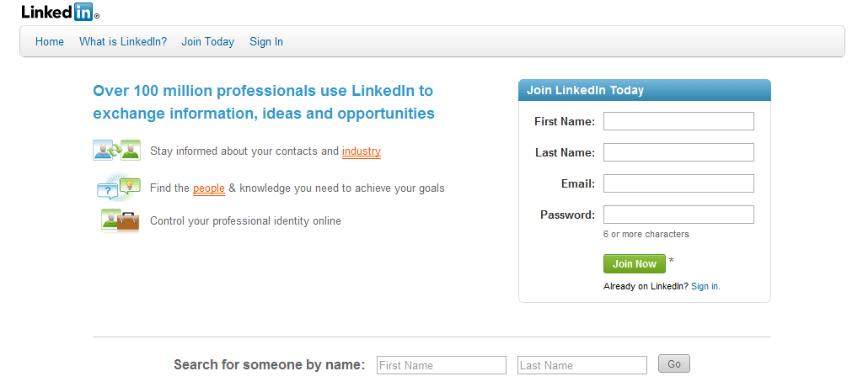
Getting Started
www.linkedin.com
Creating Your Professional Profile
“Users with complete profiles are 40 times more likely to receive opportunities through LinkedIn.”

Slide 5
Upload A Resume
Users can upload their resume to fill out their LinkedIn profile. Advantages include:
Showing up in more searches that prospective employers run.
Having more compatible recommended jobs show up on your side bar.
Getting a listing of past and present colleagues to enhance your network.

Slide 6
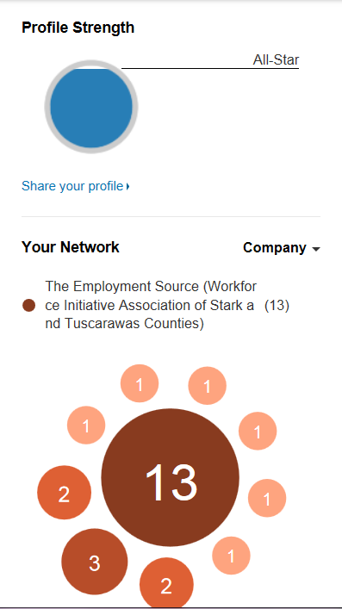
Profile Strength & Network
The more skills, expertise, and recommendations you have the stronger your profile will be.
The Stronger your profile the better
Your Network consists of the individuals that you are “connected” to and their connections.
The larger your Network the better

Slide 7
Making Connections
LinkedIn Connections should represent your “Real World” Connections.
Colleagues
Friends
Classmates
Business Partners
Important: It is great to add connections because it enhances your network; however, if you add people who indicate they do not know you LinkedIn has the right to lock you out.

Slide 8
How your Network works!
Networks Consist of first, second, and third connections
You
Your Coworker Julie
Your boss Mark
Your previous Professor Sally
2nd Connection
3rd Connection
1st Connection
Julie’s Connection Tom
Tom’s Connections
Mark’s Connection Lisa
Lisa’s Connection
Sally’s Connection Joy
Joy’s Connections

Slide 9
Recommendations
Ask for recommendations from colleagues, and business partners.
“*** is an energetic and very knowledgeable HR professional. I've worked with ** * in our local SHRM chapter and he has always presented creative ideas and is very dependable with his follow through.”
Lori- Resource Room Specialist The Employment Source April 2011
Recommendations are followed by the name and professional position of the person who posted it and the date.

Slide 10
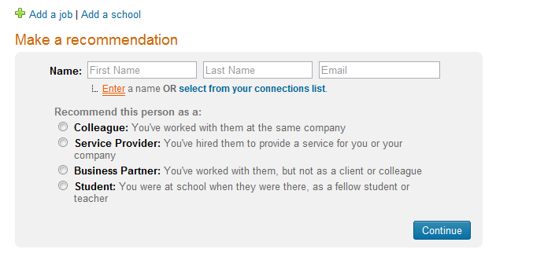
Recommendations
Make professional recommendations for individuals in your network.

Slide 11
Job Postings
The jobs that LinkedIn recommend for you are based on the experience you provide.
Search for jobs by keyword, company, or industry.

Slide 12
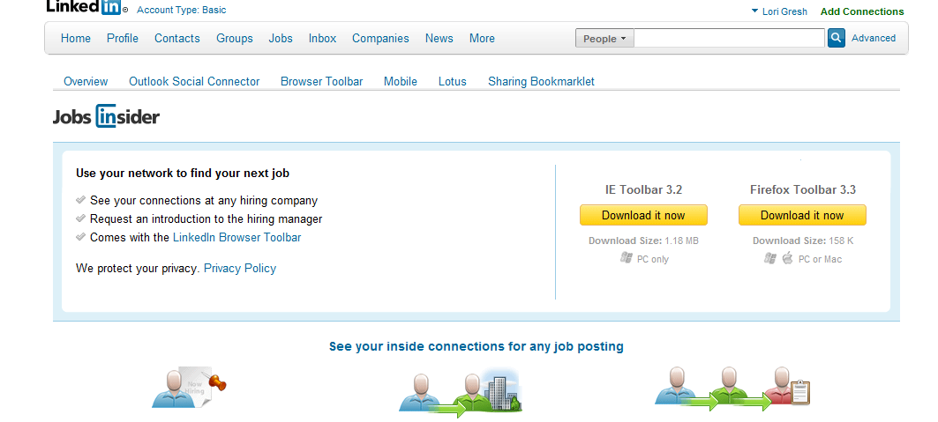
Job Insider Toolbar
Download into your browser and view LinkedIn connections with past or present experience in companies you’re interested in.

Slide 13
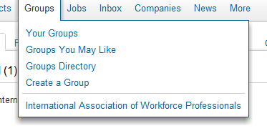
*Join Groups, with topics that are of interest and concern to you. *Keep up-to-date on the latest news and trends of specific issues.
Groups

Slide 14
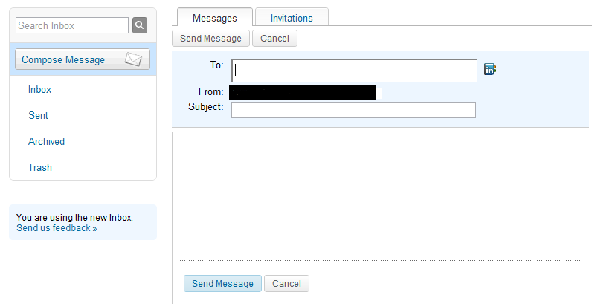
This is how you communicate with other professionals on LinkedIn. Send Messages to reconnect with past colleagues, friends, or business partners. It is like sending an email, only doing it through LinkedIn.
Inbox/Messages

Slide 15
Companies
Follow companies that you have an interest in.
Great way to research a company before an interview.
Find out what people hold what positions.
Keep current with changes and possible openings going on within a particular company.

Slide 16
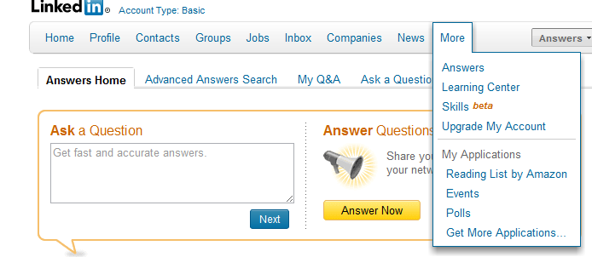
Questions & Answers
Post professional inquiries on LinkedIn, and have them answered by experts.

Slide 17
For Your Information
Be aware of what you post on all Social Networking Domains.
Employers can run Social Networking background checks.
When doing a Google search on someone, LinkedIn should be one of the first results to come up.
Let your first impression be a good one!

