Slide 1
LinkedIn and Your Job Search: Best Practices for Rock Star Results
Janet Matelski-Smith January 9, 2018

Slide 2
The Hidden Job Network
Courtesy of : https://www.payscale.com/career-news/2017/04/many-jobs-found-networking

Slide 3
Best Practices for Rock Star Results - Profile Strength -
Photo
Headline
Summary
Experience
Connections (# and types)
Profile Settings

Slide 4
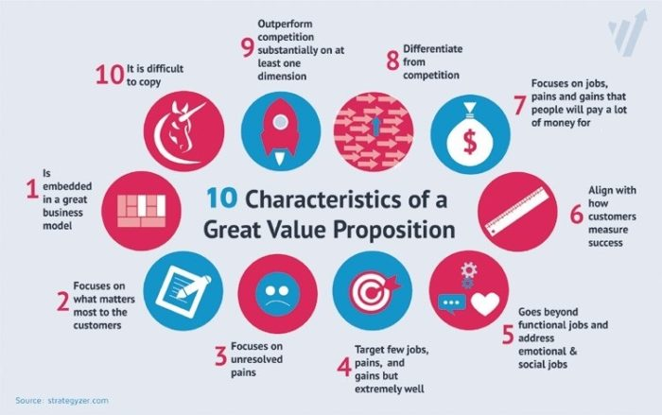
Headline + Summary = Value Proposition
I am (insert professional title).
I help (insert target audience) do/understand (insert a description of what you do).
Courtesy of : https://digitalbrandinginstitute.com/be-a-linkedin-rockstar/
Courtesy of : https://www.linkedin.com/pulse/new-survey-reveals-85-all-jobs-filled-via-networking-lou-adler

Slide 5
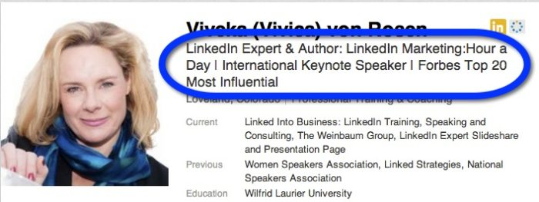
Headline + Summary = Value Proposition
Courtesy of : https://digitalbrandinginstitute.com/be-a-linkedin-rockstar/
Courtesy of : https://www.linkedin.com/pulse/new-survey-reveals-85-all-jobs-filled-via-networking-lou-adler

Slide 6
Experience = Rock Star Recognition
Courtesy of : https://expandedramblings.com/index.php/linkedin-job-statistics/

Slide 7
Connections: # and Types
PERSONAL MESSAGE
15%
SHARED GROUP
21%
SHARED EMPLOYER
27%
Courtesy of : https://expandedramblings.com/index.php/linkedin-job-statistics/
Notes:
Multiple sources agree that customized connection requests and InMail messages increases response rates by a minimum of 15%.
Contacting someone you are not connected to directly but are connected by a group increases response rates by a minimum of 21%.
Referencing a shared employer in your connection/networking message increases response rates by 27%.
If 92% of recruiters use LinkedIn as their #1 social media recruiting and vetting tool (yet only half of all job seekers use LinkedIn at 36%), it makes sense to find mutual groups.

Slide 8
Profile Settings: Privacy May be a Bad Thing
Go Public, or Go Home!
Notes:
(NOTE: IT IS NO LONGER RECOMMENDED TO ACTIVATE PRIVACY MODE UNLESS YOU ARE WILLING TO LOSE ALL OF YOUR HISTORICAL PROFILE VIEWS DATA)

Slide 9
Profile Settings: Job Seeking Specifics
Sharing your profile when you click apply:
Active Job-Seekers – select Yes
Increases chance application will be viewed
Let recruiters know you’re open to opportunities:
In-Transition – select Yes
Currently Employed – select No (no privacy guarantee)
Notes:
Under Me, View profile, Settings & Privacy, Privacy: Job seeking
Refer to How to Be Found on LinkedIn (rev 08082017) for more details.
Refer to my January presentation and materials for additional tips and tricks to strengthen your profile! ☺

Slide 10
Accessing the Wi-Fi Network
akgenwifi

Slide 11
Activity: Value Proposition
I am (insert professional title).
I help (insert target audience) do/understand
(insert a description of what you do).
Courtesy of : https://digitalbrandinginstitute.com/be-a-linkedin-rockstar/
Courtesy of : https://www.linkedin.com/pulse/new-survey-reveals-85-all-jobs-filled-via-networking-lou-adler

Slide 12
Activity: Groups
Advanced Search
1,908 Members
Courtesy of : https://www.linkedin.com/pulse/new-survey-reveals-85-all-jobs-filled-via-networking-lou-adler

Slide 13
Activity: Potential Contacts
Advanced Search
Courtesy of : https://www.linkedin.com/pulse/new-survey-reveals-85-all-jobs-filled-via-networking-lou-adler

Slide 14
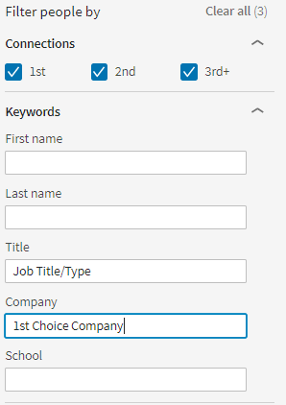
Advanced Search Function - People -
Select People
Connections – check all 3
Title – job title/type
Company – 1st choice employer
Don’t stop there!!! (Locations, Current companies, Past companies, Industries, Schools)
Notes:
(NOTE: IT IS NO LONGER RECOMMENDED TO ACTIVATE PRIVACY MODE UNLESS YOU ARE WILLING TO LOSE ALL OF YOUR HISTORICAL PROFILE VIEWS DATA)
You’ve identified your search parameters and found the Advance Search function – now, let’s put it all to work! (Warning: Do NOT connect or message anyone in your search results until after the third section of this training session has been reviewed.)
In the Advanced Search interface, click on People
Check all three options under Connections (1st, 2nd, and 3rd+); note you can always uncheck these later if your search results are too plentiful
Enter your search criteria:
Keywords – 1st Job Title/Type and 1st Choice Company
Locations – do you have any geographic preferences or restrictions?
Current companies – leverage this to streamline results to ONLY people currently employed at your desired company
Past companies – leverage this to streamline results to people who USED to work at your desired company (great for research and recon to validate a company being on your target list; may not always be as directly beneficial for immediate job openings as Current companies search filter)
Industries – this filter can enhance your search results (expand upon job title/type, get industry-specific, etc.)
Schools – great for searching for alumni from your alma mater; also good if you are looking to network with people that could provide insights on future education needs
Note: Results will update each time you add/remove filter parameters with a checkbox; for filters set by typing in a textbox, clear or update the text and hit Enter to update results; take care that other desired filters do not inadvertently get removed during this process.
Repeat for each job title/type and company. You should be able to identify no less than three (3) potential contacts per job title/type and/or company to consider it a valid search.
As you find potential connections, right-click on the person’s name and select “Open link in new tab/window.” We’ll discuss best practices on how to have the most successful request responses in the next section.

Slide 15
Connections – check all 3 to start
Keywords – 1st Job Title/Type and 1st Choice Company
Locations – Preferences?
Current companies – current culture and connections
Past companies – company background
Industries – Expand/Restrict?
Schools – Alma Mater
Repeat for each job title/company!
Notes:
(NOTE: IT IS NO LONGER RECOMMENDED TO ACTIVATE PRIVACY MODE UNLESS YOU ARE WILLING TO LOSE ALL OF YOUR HISTORICAL PROFILE VIEWS DATA)
You’ve identified your search parameters and found the Advance Search function – now, let’s put it all to work! (Warning: Do NOT connect or message anyone in your search results until after the third section of this training session has been reviewed.)
In the Advanced Search interface, click on People
Check all three options under Connections (1st, 2nd, and 3rd+); note you can always uncheck these later if your search results are too plentiful
Enter your search criteria:
Keywords – 1st Job Title/Type and 1st Choice Company
Locations – do you have any geographic preferences or restrictions?
Current companies – leverage this to streamline results to ONLY people currently employed at your desired company
Past companies – leverage this to streamline results to people who USED to work at your desired company (great for research and recon to validate a company being on your target list; may not always be as directly beneficial for immediate job openings as Current companies search filter)
Industries – this filter can enhance your search results (expand upon job title/type, get industry-specific, etc.)
Schools – great for searching for alumni from your alma mater; also good if you are looking to network with people that could provide insights on future education needs
Note: Results will update each time you add/remove filter parameters with a checkbox; for filters set by typing in a textbox, clear or update the text and hit Enter to update results; take care that other desired filters do not inadvertently get removed during this process.
Repeat for each job title/type and company. You should be able to identify no less than three (3) potential contacts per job title/type and/or company to consider it a valid search.
(Today, we are focusing on identifying people within the company and department you would like to work for, but you can adjust the way you use these filters to suit different outcomes.)
As you find potential connections, right-click on the person’s name and select “Open link in new tab/window.” We’ll discuss best practices on how to have the most successful request responses in the next section.

Slide 16
Communication: Order of Operations
C - Connect FIRST
A - Ask for the Meeting SECOND
N – NEVERs
Notes:
Refer to following slides with additional detail.

Slide 18
Homework Assignment
Join NCENG LinkedIn Group
Post any unanswered questions from today
Share your rock star results with the group!
Notes:
Additional Resource – LinkedIn Personal Profile Cheat Sheet by Lisa K. McDonald: http://www.careerpolish.com/linkedin-character-limits.html?lipi=urn%3Ali%3Apage%3Ad_flagship3_pulse_read%3BEoZ8lp4nR72KofRlnCdh8A%3D%3D

