Slide 1
Tell Your Story to be MEMORABLE!
Katherine Burik
The Interview Doctor, Inc. ®
© The Interview Doctor, Inc. ® 2021 All Rights Reserved www.InterviewDoctor.com 330-495-2337

Slide 2
Memorable?

Slide 3
Today
Storytelling
Tie to interview
Improve
Breakout to practice
Debrief

Slide 4
30 FAQs
Assumptions
Wing it
BLAH!

Slide 5
Need a better approach
to be memorable

Slide 6
What do you want them to remember?

Slide 7
Structure your prep around that

Slide 8
Tell your story
Support your brand
Fit with culture
Represent

Slide 9
Stories are 22 times more memorable than facts
https://www.quantifiedcommunications.com/blog/storytelling-22-times-more-memorable

Slide 10
Why?
https://www.quantifiedcommunications.com/blog/storytelling-22-times-more-memorable

Slide 11
Why?
Forge connections
Convey values
Evoke emotions
https://www.quantifiedcommunications.com/blog/storytelling-22-times-more-memorable

Slide 12
Identify a threat and/or an opportunity.
Establish victims of the threat or denied opportunity.
Suggest villains that impose the threat or deny the opportunity.
Propose solutions. Reveal the hero.
~ Mark McKinnon, Showtime’s The Circus

Slide 13
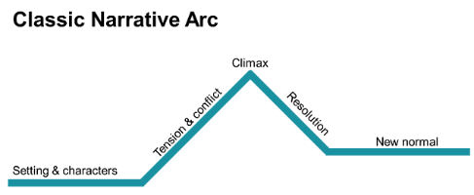
https://www.quantifiedcommunications.com/blog/storytelling-22-times-more-memorable

Slide 14
Memorable?

Slide 15
Try that again, with passion!

Slide 16
Let’s tie stories to interviews

Slide 17
Narrative arc
Behavioral response
YOUR
STORY

Slide 18
Past experience predicts future performance
Compared to what?
18

Slide 19
What it takes to be
SUCCESSFUL!
19

Slide 20
Critical Success Factors
20

Slide 21
Supply Chain Director?
Problems solved
Operation smooth
Customers happy
21

Slide 22
What is YOUR critical success factor?

Slide 23
How to demonstrate critical success?
COMPETENCIES

Slide 24
Competencies
Knowledge
Skills
Abilities
Behavior

Slide 25
Competencies – for example?!?
Knowledge
Skills
Abilities
Behavior

Slide 26
Convert competency to behavioral interview question
Behavior
Tell me about a time when…

Slide 27
Convert competency to behavioral interview question
Behavior
Tell me about a time when…
Detail oriented
you had to work on a project with lots of moving parts

Slide 28
Make some questions!

Slide 29
Stories are
Answer with a STORY
MEMORABLE

Slide 30
Accomplishment stories’ toolkit

Slide 31
Story has 4 parts
Beginning
Middle
End
What I learned

Slide 32
Sounds like…
Beginning
One time…
Middle
So I did this…
End
For this result…
I learned that…

Slide 33
What experiences demonstrate YOUR successful future?

Slide 34
Volunteer a story
Break down into 4 parts – narrative arc
What is point – big question?
Characters, emotion?
Edit to eliminate unneeded detail
Breakout Session

Slide 35
Practice

Slide 36
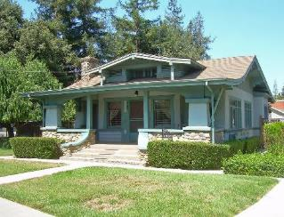
10 seconds
2 – 3 minutes
all day long

Slide 37
Use stories anyway!
What if interviewer doesn’t offer
opportunity for a story?

Slide 38
Let’s practice
Frequently asked question?

Slide 39
Stories are memorable
Make your stories count!
Passion
Emotion
Energy

Slide 40
Special Offer
Take my free Quiz online https://interviewdoctor.com/quiz/
Book a call
www.Calendly.com/interviewdoc/call
^{www.InterviewDoctor.com}
^{Katherine@InterviewDoc.com}

Slide 41
Questions?
Reach out any time! We can help you turn your career dreams into reality!
Katherine Burik
The Interview Doctor, Inc. ®
^{www.InterviewDoctor.com}
^{Katherine@InterviewDoc.com}
www.Calendly.com/interviewdoc/call

Slide 42
AI & Video Interviews

