Slide 1
LinkedIn and Your Job Search: Network Like a Superhero
Janet Matelski-Smith August 8, 2017

Slide 2
May the Odds be Ever in Your Favor
85% of critical jobs are filled (and found) via Networking!
Courtesy of : https://www.linkedin.com/pulse/new-survey-reveals-85-all-jobs-filled-via-networking-lou-adler
Notes:
Regardless of employment status, networking is, by far, the most common way to find your next job. Chart from Lou Adler’s article, New Survey Reveals 85% of All Jobs are Filled via Networking, published on February 29, 2016.
Survey respondents as of date of publication: 3,000 (most in staff or management roles)
As we move forward, we will focus on three things today: 1) Profile Strength, 2) Identifying Potential Networking Contacts, and 3) Communication/Rules of Engagement. This will ensure that the time you spent is as effective AND efficient as possible, freeing you up for other networking and job-seeking activities and allowing for smoother pipeline management.

Slide 3
Network Like a Superhero! - Profile Strength -
Faster than Completing an Application *
More Powerful than Google Fiber *
Able to Leap Time Zones and State/ Country Borders *
* Disclaimer: These statements are strictly metaphorical; do not attempt to race an online HRIS system, overpower Google, or skip Customs
without first consulting your doctor and/or an attorney.
.
Notes:
Superhero Networking is all about overcoming the traditional physical and technological barriers that can hinder successful job-seeking. Instead of hiding behind a computer, hoping your application gets through AND is selected for an initial interview, put your computer to work for you to build essential contacts that could be critical to your job search.
Profile Strength is the cornerstone for a highly impactful LinkedIn engagement and Microsoft continues to tweak settings within the interface to drive participation and authenticity while reducing trolling.
Profile Strength boils down to FINDABILITY, CREDIBILITY, and RELATABILITY. As noted in my January 2017 presentation materials, more and more Hiring Managers and HR Personnel are leveraging LinkedIn to “get to know” an applicant before they even schedule the initial interview! Odds are, your LinkedIn Profile is making a first impression, whether you want it to or not, so let’s make sure it works to your advantage.

Slide 4
Accessing the Wi-Fi Network
Enter Name of Wi-Fi Network Here

Slide 5
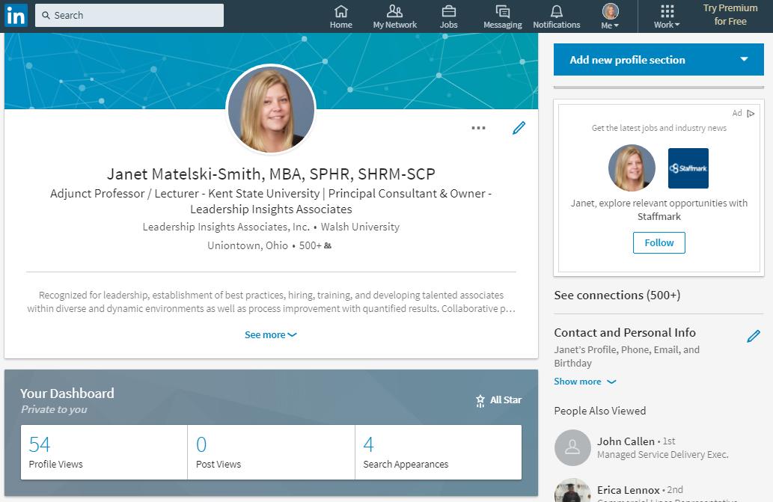
Profile Strength: Profile Metrics
Notes:
View from Me, View My Profile (after LogIn)
Photo – according to an article in the LinkedIn Official Blog, LinkedIn Profile Photo Tips: Introducing Photo Filters and Editing, written by Anwesha Jalan and published March 14, 2017, having a photo in your profile not only helps people recognize you, but can also result in:
Up to 21x more profile views
Up to 36x more messages
Up to 9x more connection requests
While the article doesn’t provide a statistic for this, it also greatly increases the likelihood someone will accept your connection request and/or any networking requests
Name, Headline, Current Position, Education, Location
# of Contacts
Summary
# of Profile Views
# of Post Views
# of Search Appearances (this section may be replaced with Views of your post in the feed or other relevant metrics)
Profile Strength (e.g., All Star status, etc.)
Link to article: https://blog.linkedin.com/2017/march/14/linkedin-profile-photo-tips-introducing-photo-filters-and-editing

Slide 6
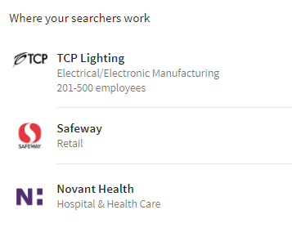
Search Appearances: Data & Statistics
Notes:
Newer functionality within LinkedIn under Me, View My Profile
Allows user to how his/her profile has shown up in searches by others, where those searchers work, and what those searchers do (job title). This may be one of the features designed to entice users to purchase LinkedIn Premium, but it is not clear as of the date of this presentation.
Note: It may be worthwhile to go back and check out “Who’s viewed your profile” and consider sending connection requests (especially to recruiters).

Slide 7
Profile Strength: Profile Settings
Sharing your profile when you click apply:
Active Job-Seekers – select Yes
Increases chance application will be viewed
Let recruiters know you’re open to opportunities:
In-Transition – select Yes
Currently Employed – select No (no privacy guarantee)
Notes:
Under Me, View profile, Settings & Privacy, Privacy: Job seeking
Refer to How to Be Found on LinkedIn (rev 08082017) for more details.
Refer to my January presentation and materials for additional tips and tricks to strengthen your profile! ☺

Slide 8
Network Like a Superhero! - Identifying Potential Contacts -
Faster than Completing an Application *
More Powerful than Google Fiber *
Able to Leap Time Zones and State/ Country Borders *
* Disclaimer: These statements are strictly metaphorical; do not attempt to race an online HRIS system, overpower Google, or skip Customs
without first consulting your doctor and/or an attorney.
.
Notes:
Superhero Networking is all about overcoming the traditional physical and technological barriers that can hinder successful job-seeking. Instead of hiding behind a computer, hoping your application gets through AND is selected for an initial interview, put your computer to work for you to build essential contacts that could be critical to your job search.
Leveraging LinkedIn for networking contacts (in addition to your other networking and job-seeking activities), allows you to effectively and efficiently expedite access to the 85% of job postings discussed on Slide 2. Added bonuses: elimination of geographical constraints and access to a potentially “new” group of individuals that you might not otherwise easily meet. Put your sales hats on and let’s get started!

Slide 9
Identifying Potential Contacts
Search Parameters:
3 Job Titles/Types
3 Companies
Location(s) – if applicable
Industry/ies – if applicable
Schools
Notes:
First, we need to take a few minutes and think about what WE want for ourselves. These wants/desires will help shape our search parameters. Don’t worry about whether or not a job is posted YET; in fact, it may be better if one isn’t posted (as we’ll discuss later).
Identify:
3+ Job Titles / Types – what job title are you looking for? What is the job title of the person you would most likely report to? (Note: it is best to use one job title/type at a time for this search.)
3+ Companies you would like to work for
Location(s) – do you need to stay local or are you open to relocation? If open to relocation, do you have a desired city/state/country?
Industry/ies – do you have a desired Industry you would like to stay within, expand into, or avoid?
Schools – where did you go to school? (Note: This may restrict your search too much if you attended a smaller university/trade school; you may need to uncheck this filter to get more results.)

Slide 10
Notes:
Ruh-roh, Raggy! Did Microsoft get rid of the Advanced Search function in LinkedIn???

Slide 11
Click in Search box in banner
Click on Magnifying Glass
Congratulations! You have found the Advanced Search function!
Notes:
Nah, Scoob, it’s just harder to find.

Slide 12
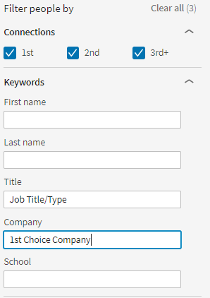
Advanced Search Function - People -
Select People
Connections – check all 3
Title – job title/type
Company – 1st choice employer
Don’t stop there!!! (Locations, Current companies, Past companies, Industries, Schools)
Notes:
(NOTE: IT IS NO LONGER RECOMMENDED TO ACTIVATE PRIVACY MODE UNLESS YOU ARE WILLING TO LOSE ALL OF YOUR HISTORICAL PROFILE VIEWS DATA)
You’ve identified your search parameters and found the Advance Search function – now, let’s put it all to work! (Warning: Do NOT connect or message anyone in your search results until after the third section of this training session has been reviewed.)
In the Advanced Search interface, click on People
Check all three options under Connections (1st, 2nd, and 3rd+); note you can always uncheck these later if your search results are too plentiful
Enter your search criteria:
Keywords – 1st Job Title/Type and 1st Choice Company
Locations – do you have any geographic preferences or restrictions?
Current companies – leverage this to streamline results to ONLY people currently employed at your desired company
Past companies – leverage this to streamline results to people who USED to work at your desired company (great for research and recon to validate a company being on your target list; may not always be as directly beneficial for immediate job openings as Current companies search filter)
Industries – this filter can enhance your search results (expand upon job title/type, get industry-specific, etc.)
Schools – great for searching for alumni from your alma mater; also good if you are looking to network with people that could provide insights on future education needs
Note: Results will update each time you add/remove filter parameters with a checkbox; for filters set by typing in a textbox, clear or update the text and hit Enter to update results; take care that other desired filters do not inadvertently get removed during this process.
Repeat for each job title/type and company. You should be able to identify no less than three (3) potential contacts per job title/type and/or company to consider it a valid search.
As you find potential connections, right-click on the person’s name and select “Open link in new tab/window.” We’ll discuss best practices on how to have the most successful request responses in the next section.

Slide 13
Connections – check all 3 to start
Keywords – 1st Job Title/Type and 1st Choice Company
Locations – Preferences?
Current companies – current culture and connections
Past companies – company background
Industries – Expand/Restrict?
Schools – Alma Mater
Repeat for each job title/company!
Notes:
(NOTE: IT IS NO LONGER RECOMMENDED TO ACTIVATE PRIVACY MODE UNLESS YOU ARE WILLING TO LOSE ALL OF YOUR HISTORICAL PROFILE VIEWS DATA)
You’ve identified your search parameters and found the Advance Search function – now, let’s put it all to work! (Warning: Do NOT connect or message anyone in your search results until after the third section of this training session has been reviewed.)
In the Advanced Search interface, click on People
Check all three options under Connections (1st, 2nd, and 3rd+); note you can always uncheck these later if your search results are too plentiful
Enter your search criteria:
Keywords – 1st Job Title/Type and 1st Choice Company
Locations – do you have any geographic preferences or restrictions?
Current companies – leverage this to streamline results to ONLY people currently employed at your desired company
Past companies – leverage this to streamline results to people who USED to work at your desired company (great for research and recon to validate a company being on your target list; may not always be as directly beneficial for immediate job openings as Current companies search filter)
Industries – this filter can enhance your search results (expand upon job title/type, get industry-specific, etc.)
Schools – great for searching for alumni from your alma mater; also good if you are looking to network with people that could provide insights on future education needs
Note: Results will update each time you add/remove filter parameters with a checkbox; for filters set by typing in a textbox, clear or update the text and hit Enter to update results; take care that other desired filters do not inadvertently get removed during this process.
Repeat for each job title/type and company. You should be able to identify no less than three (3) potential contacts per job title/type and/or company to consider it a valid search.
(Today, we are focusing on identifying people within the company and department you would like to work for, but you can adjust the way you use these filters to suit different outcomes.)
As you find potential connections, right-click on the person’s name and select “Open link in new tab/window.” We’ll discuss best practices on how to have the most successful request responses in the next section.

Slide 14
Valid Search Results
Notes:
You should be able to identify no less than three (3) potential contacts per job title/type and/or company to consider it a valid search.
As you find potential connections, right-click on the person’s name and select “Open link in new tab/window.” We’ll discuss best practices on how to have the most successful request responses in the next section.
Ultimately, the goal is to find three contacts per week each at three different companies (a total of 9 contacts), connect with those contacts, and schedule networking meetings as they accept your invitations to connect. This will help you establish a pipeline of new contacts and networking meetings. Once you have landed your dream job, try to keep up with this philosophy, but scale back to three contacts total per week and three networking meeting requests if needed.

Slide 15
Network Like a Superhero! - Communication -
Faster than Completing an Application *
More Powerful than Google Fiber *
Able to Leap Time Zones and State/ Country Borders *
* Disclaimer: These statements are strictly metaphorical; do not attempt to race an online HRIS system, overpower Google, or skip Customs
without first consulting your doctor and/or an attorney.
.
Notes:
Superhero Networking is all about overcoming the traditional physical and technological barriers that can hinder successful job-seeking. Instead of hiding behind a computer, hoping your application gets through AND is selected for an initial interview, put your computer to work for you to build essential contacts that could be critical to your job search.
One of the biggest complaints from active networkers and job-seekers is, “No one replies to my requests!” Ironically, most people WANT to be helpful; however, it is the responsibility of the networker to put that person in a situation where they FEEL helpful. Let’s review some easy strategies to get the most out of your connection and networking requests.

Slide 16
Superhero Networking: Communication
7 Rules of Engagement:
Connect FIRST
Ask for the Meeting SECOND
The NEVERs
Be FLEXIBLE
Make it EASY to BE HELPFUL
BE PREPARED for the Networking Meeting
FOLLOW-UP appropriately
Notes:
Refer to following slides with additional detail.

Slide 17
7 Rules of Engagement (cont.)
Rule #1 – Connect FIRST
KISS philosophy
Increase 1st degree contacts
Mobile vs Desktop usage
Automatic “READ”
Increase likelihood to network
Notes:
Embrace the KISS philosophy (Keep It Simple Stupid):
Connect FIRST - Most people manage their LinkedIn Activity from their phones, which means accepting your connection request automatically marks the carefully crafted message your included as read. Guess what? These same people (myself included) rarely remember to go the messages section to see what you said. (Most of us have been conditioned by the auto-generated request, so we forget that someone may have said anything else.)
LinkedIn still limits InMails for those outside of your 1st degree network, so why not increase your 1st degree contacts?
Connecting first allows you to add another 1st degree connection and have a higher likelihood of getting that networking meeting. If they don’t accept your request? That’s fine – you can always send an InMail asking for the meeting; if they say yes, chances are they’ll end up becoming a 1st degree connection anyway.

Slide 18
7 Rules of Engagement (cont.)
Rule #2 – Ask for the Meeting SECOND
Secondary Messages have more weight
Increase likelihood of “Yes!”
Provide a timeline
Provide the reason (see Rule #5)
Notes:
KISS (CONT.):
Ask for your Networking Meeting SECOND
Secondary messages have a higher likelihood of getting read and responded to. If the individual has already accepted you as a contact and you follow up asking to meet in person or schedule a phone call, your name is probably still fresh in his/her brain and he/she will not be at all surprised.
ALWAYS provide a timeline – e.g., 15-30 minutes for a phone call to learn more about your experience, an hour over lunch to get to know each other better, etc. Let your contact determine if he/she wants to spend more time with you.
ALWAYS provide a reason – see Rule #5

Slide 19
7 Rules of Engagement (cont.)
Rule #3 – The NEVERs
Ask if he/she has a job for you*
Ask if the company is hiring*
Send an unsolicited resume
Assign homework
* Note: There are ways to ask this during or after the networking meeting without putting your contact on the spot or coming across as unprepared
Notes:
KISS (CONT.):
NEVER
Ask if he/she has a job for you or if the company is hiring
While there are exceptions to this rule, it’s a good rule to follow. For example, sales people are expected to always be closing, so it might be appropriate to ask a version of this question AFTER THE NETWORKING MEETING HAS TAKEN PLACE (or towards the end of the meeting).
Understand, there are risks to this and you will need to frame this type of question VERY carefully. EXAMPLE: What job title should I keep an eye out for on your company job board?
I also recommend avoiding asking about job availability hiring during the networking session unless the person you reached out to brings it up. Even then, tread lightly and do NOT come unprepared. “Are you hiring?” may sound like you didn’t check the company job board, whereas, “Wow! I’d love the opportunity to join your team/department/division someday. I’ve been keeping an eye on the job board, but I’m not sure which job titles to look for – do you have any suggestions?” could much better received under the appropriate circumstances.
Send an unsolicited resume – this is the equivalent of issuing homework to someone who volunteered to help the class.
DON’T email your resume unless he/she asks you to; BUT, you should bring an updated copy to the meeting in case an opportunity comes up to share it.
If you are asked to share your resume, send via regular email as LinkedIn sometimes does funky things to the formatting, even in PDF.
Assign homework – avoid the appearance of you assigning the contact a task; let him/her volunteer to call you, etc. but make it easy for them

Slide 20
7 Rules of Engagement (cont.)
Rule #4 – Be FLEXIBLE
Accommodation is key
In-Person
Phone Call
Skype/Videoconferencing
Notes:
KISS (CONT.):
Be FLEXIBLE – everyone is busy, and being flexible can be the difference between landing the networking meeting and it never taking place.
In-person meetings are ideal – offer to come to the office, meet for coffee or lunch (but only if you are prepared to buy)
Phone calls – if your contact is not in close proximity or if he/she has a crazy-busy schedule, offer the option of talking by phone and ALWAYS ask if they would prefer you call them at the scheduled time;
Skype/Videoconferencing – this can be a great option, especially if your contact is far away but you want it to feel more personal; make sure you are comfortable with the technology before extending/accepting this offer, though.

Slide 21
7 Rules of Engagement (cont.)
Rule #5 – Make it EASY to BE HELPFUL
Know what to ask for
Sincerity
Confidence
Setting Contact up for Success = YOUR Success
Notes:
KISS (CONT.):
Make it EASY to BE HELPFUL
The request to network is all about building the relationship and making sure that individual is clear on why you are contacting them (aka, how they can best help you). Asking about job availability or if he/she is hiring before you’ve even built rapport is a sure-fired way to get no response or the ever-dreaded, “Please keep an eye on our job board for open positions – best wishes!”
Best options for securing a networking meeting are being sincere, confident (insincerity and desperation can destroy a networking opportunity with Gandhi), and setting the recipient up for success. Relate to them and ask for time on his/her calendar for things like insight as to how he/she accomplished so much in his/her career, how he/she got started in this line of work, how he/she got a foot in the door at XYZ Company. Things like, “I’m looking to meet with people that have the job I’d love to have five years from now so I can learn how they did it,” are great ways to open dialogue and make the person you’re reaching out to feel helpful.
Giving the contact EASY, ATTAINABLE, CLEAR ways to help you will make him/her more willing to volunteer their time.

Slide 22
7 Rules of Engagement (cont.)
Rule #6 – BE PREPARED for the Networking Meeting
Agenda
Resume
Abbreviated STAR Stories
Research – job board, contact, company website, etc.
Notes:
KISS (CONT.):
BE PREPARED for the Networking Meeting
Have an agenda set for yourself ahead of time to avoid awkward pauses and general weirdness – approach it like the part of an interview where you get to ask your applicant questions. Examples: What do you like most about working at XYZ Company? What made you decide to leave ABC to come to XYZ? What do you like most about your job? How would your team/department/division/company define success – for themselves and their associates? (and maybe their customers?)
DON’T email your resume unless he/she asks you to; BUT, you should bring an updated copy to the meeting in case an opportunity comes up to share it.
Be prepared to RELATE – if John Doe eludes to a potential need for someone with your skillset, don’t hesitate to connect those dots. Abbreviated STAR stories are great for this – e.g., John Doe mentions that the next project manager they hire may need to help roll out a new system; your response, “I helped launch Salesforce for the Services Division at my last employer; I created some best practices that ended up being rolled out company-wide and leadership was very pleased with how smoothly it went. Would this be the type of experience they (or you) would be looking for?”
I also recommend avoiding asking about job availability hiring during the networking session unless the person you reached out to brings it up. Even then, tread lightly and do NOT come unprepared. “Are you hiring?” may sound like you didn’t check the company job board, whereas, “Wow! I’d love the opportunity to join your team/department/division someday. I’ve been keeping an eye on the job board, but I’m not sure which job titles to look for – do you have any suggestions?” could much better received under the appropriate circumstances.

Slide 23
7 Rules of Engagement (cont.)
Rule #7 – FOLLOW-UP Appropriately
Getting the Networking Meeting
Got the Networking Meeting
Had the Networking Meeting
Stay in touch!
Notes:
KISS (CONT.):
FOLLOW-UP appropriately
If you don’t hear back right away on your initial request, don’t stress – there are other contacts to be made. Don’t forget to follow-up, either. Allow at least seven (7) days to pass prior to any follow-up requests. Remember, not everyone lives on social media and you want to make the best impression possible on someone you haven’t yet met.
Got the contact and the meeting is scheduled? Send a calendar invite with reminders (via your email provider) assuming John Doe’s email is provided in LinkedIn. Depending on how far out it is scheduled, you may want to send a confirmation email the day prior to your meeting/call/Skype session.
Got the contact, scheduled the meeting, and the meeting took place?
SEND A THANK YOU! This will reinforce any positive impression made during your networking session.
Remember to stay in touch – this is a relationship to be fostered, not a pair of one-day contact lenses to be tossed aside after one use.

Slide 25
Homework Assignment
3 Contacts each @ 3 Companies per week
Join NCENG LinkedIn Group
Comment on how YOU network like a Superhero!
Notes:
3 Contacts each at 3 Companies per week:
Send Connection requests to three contacts each at three companies (9 total) each week for the next few weeks
As those requests are accepted, follow-up with requests for networking meetings (keep in mind the Rules of Engagement outlined in this presentation)
See how many networking meetings you can set up by the end of the month!
Join the North Canton Executive Networking (NCENG) Group on LinkedIn – if you have not already joined our Group on LinkedIn, please do to take advantage of updates and great conversation! Make sure you have your Group Settings set as follows: check the box next to Activity (Send me an email for each new conversation) and have your Digest Email checked and set to Daily Digest. This ensures you receive notifications of job postings and other pertinent updates.
Comment on how YOU network like a Superhero!
Once you’ve joined the NCENG Group, find the conversation started in today’s session and post your success stories on networking like a Superhero.
Share other tips and tricks for mastering the Advanced Search function to help out your fellow networkers and job-seekers!

