Slide 1
Tips and Techniques for Using LinkedIn
Clark Harvey
Arrowhead Talent Solutions
clarkharvey@arrowheadtalentsolutions.com
330.316.0867

Slide 2
My Bio
President, Arrowhead Talent Solutions
Executive Director, Brighter Days Foundation
Worked at companies like Timken, Diebold, Kenan Advantage Group, and Walsh University
Held positions such as Manager – University Relations, Human Resources Manager, Senior Recruiter
Bachelor’s and Master’s degrees from Walsh
Live in North Canton

Slide 3
Agenda
Why you need a LinkedIn profile
Do’s and don’ts
Basic functionality
How to add connections and find people
How to apply to jobs
How to share updates and make posts
How to turn on “Let recruiters know you’re open”
How to research a company
Use as a sales tool
Self-awareness is foundational
A recruiter’s perspective
Q & A

Slide 4
Why you need a LinkedIn profile
Recruiters like me need you!
Great tool for a passive job seeker
Keep tabs on your network
Learning tools and courses
Apply to job postings
Help your network along the way

Slide 5
Do’s and don’ts
DO:
Use a profile picture
Check it regularly
Download the LinkedIn app
Link account to an email you check often
Market and brand yourself
Use a background image
Load your profile with keywords
Max out your skills (50)
Build your network

Slide 6
Do’s and don’ts
DON’T:
Add connections indiscriminately
Create a bare bones profile
Get personal or political
Ignore Recruiters When You’re Not Looking for a Job
Use an unprofessional picture

Slide 7
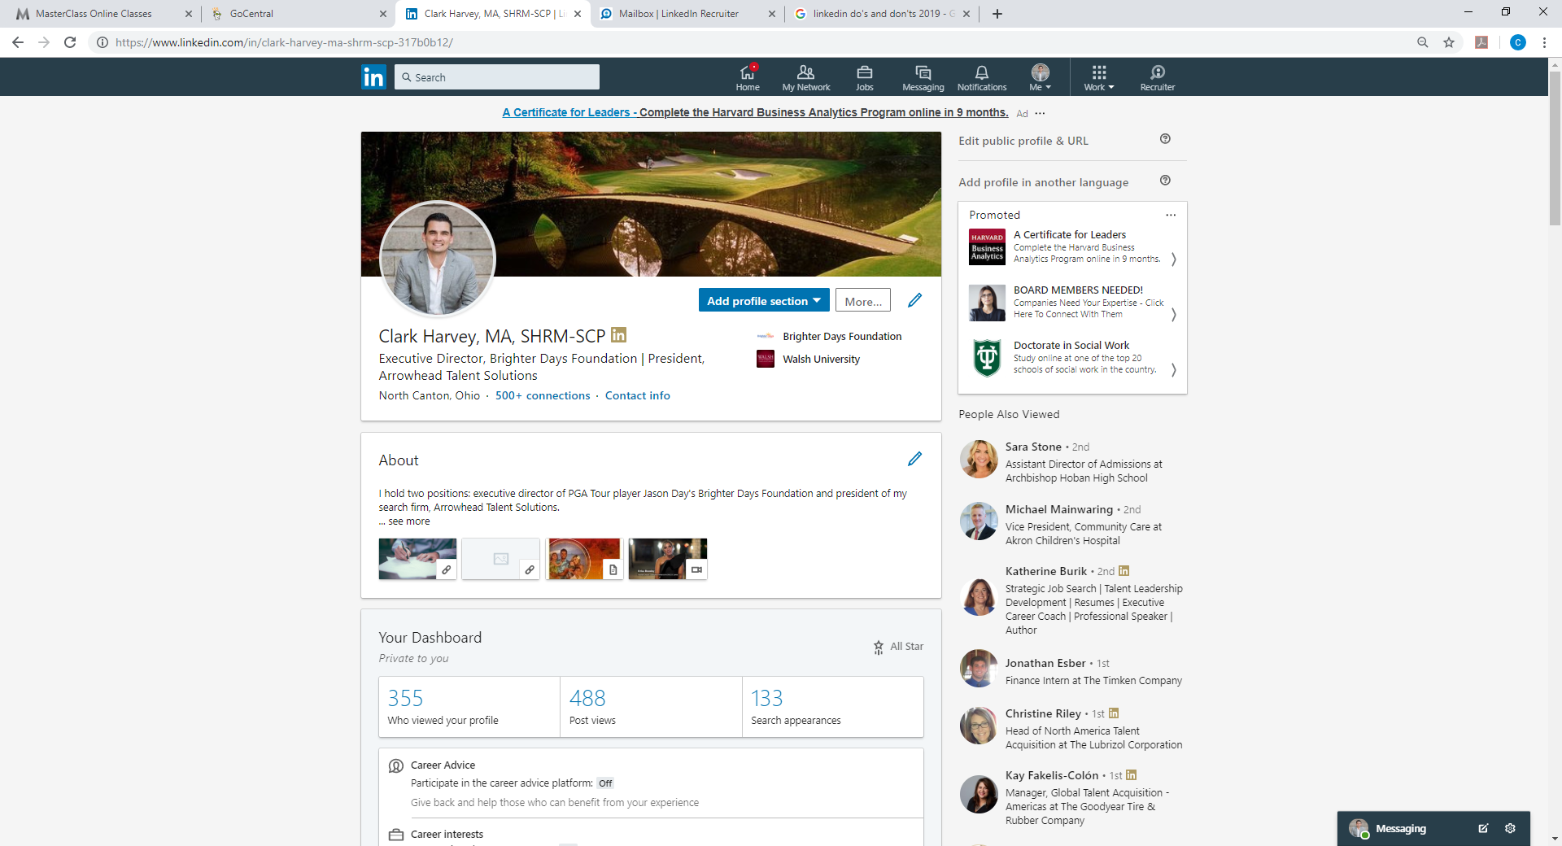
Basic functionality—your profile

Slide 8
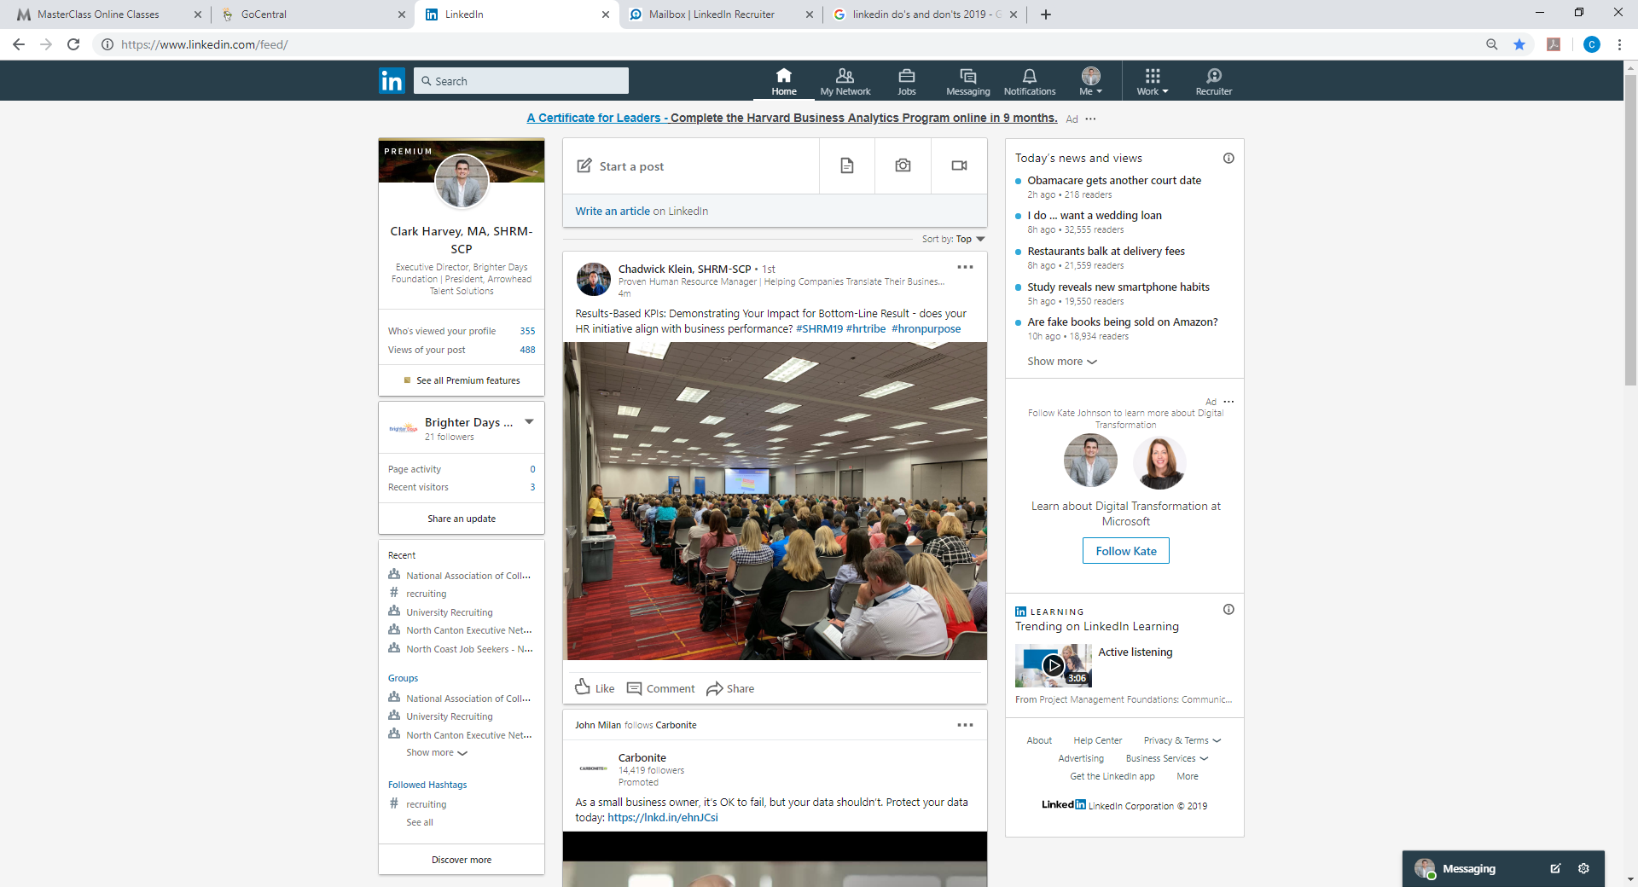
Basic functionality—home page
Tabs
News
Views
Feed
Groups

Slide 9
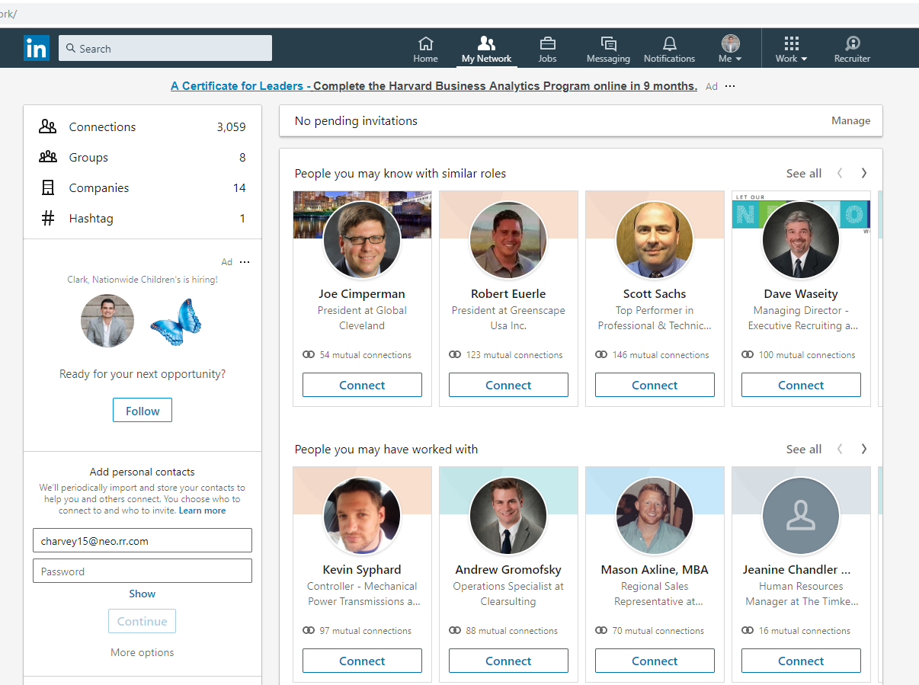
How to add connections and find people
Search Bar
My Network
Connect

Slide 10
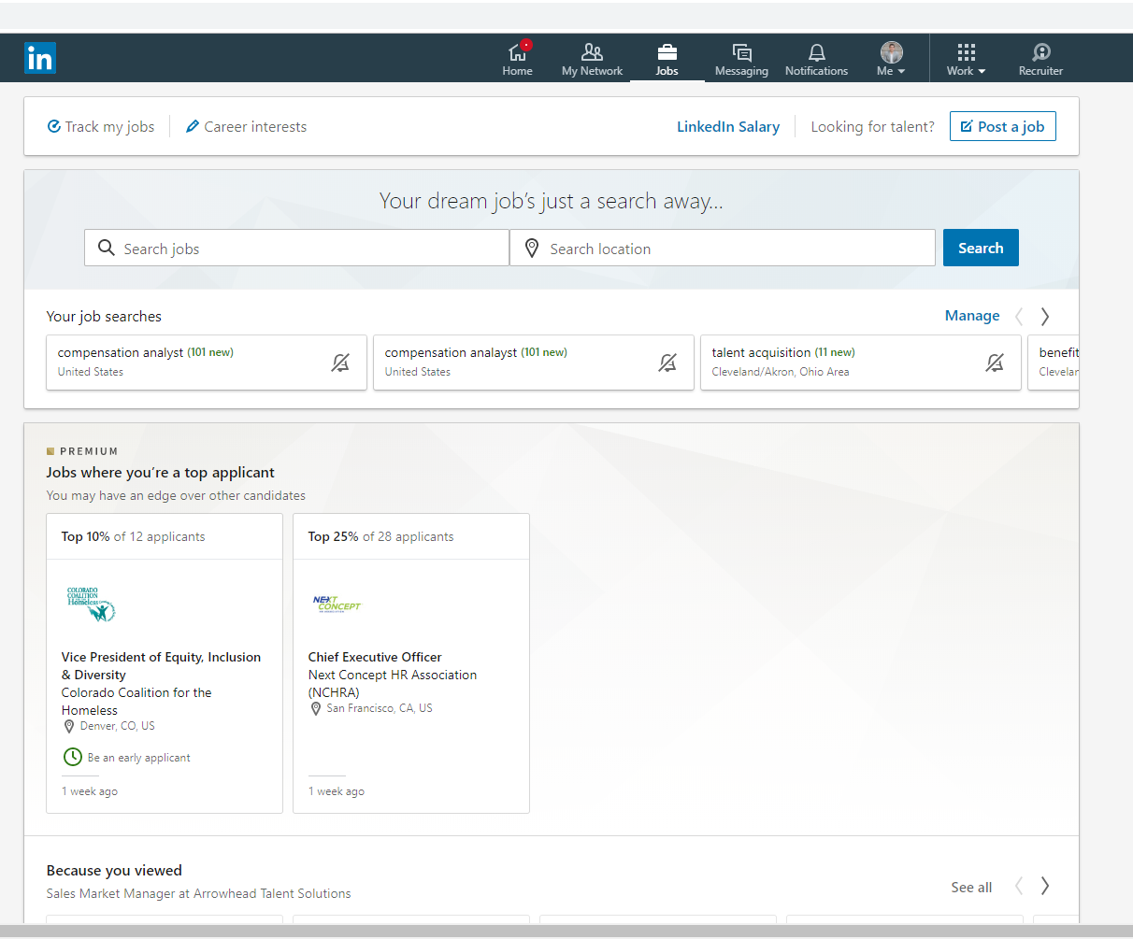
How to apply to jobs
Jobs Tab
Search Jobs

Slide 11
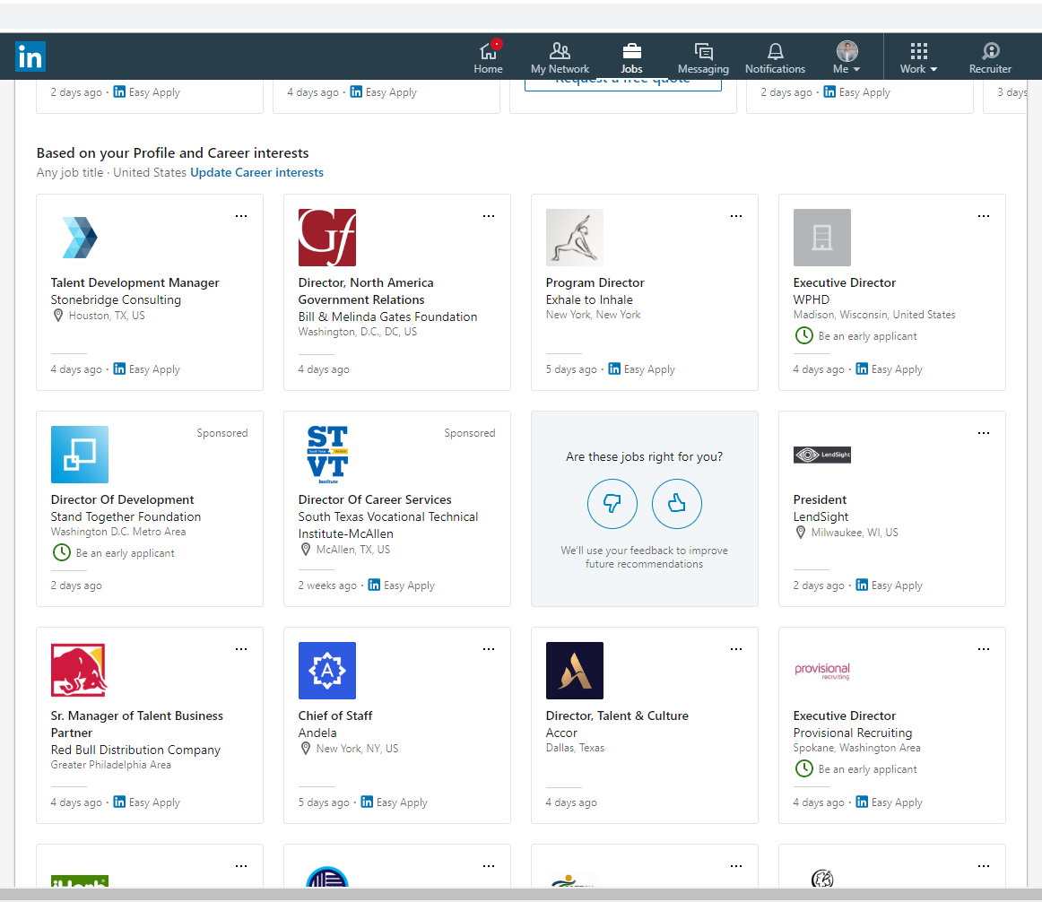
How to apply to jobs
Easy Apply

Slide 12
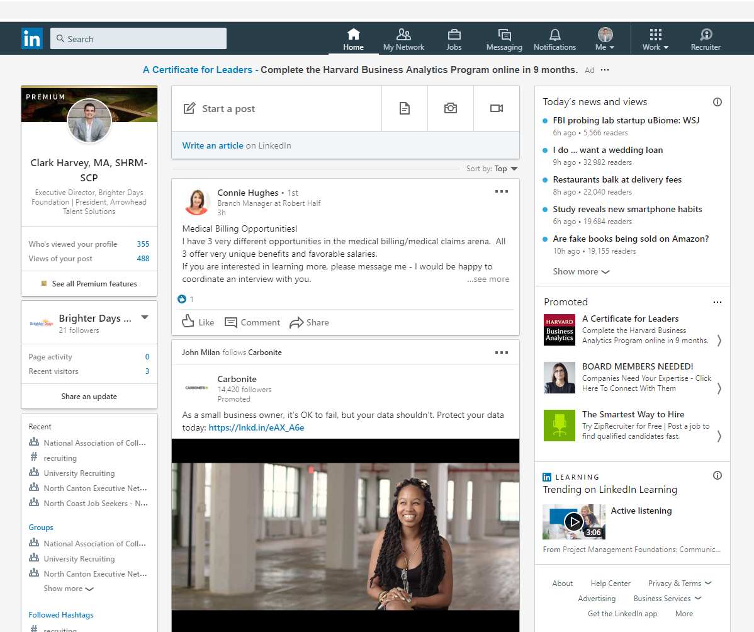
How to share updates and make posts
Post
Share

Slide 13
How to turn on “Let recruiters know you’re open”
Career Interests

Slide 14
How to turn on “Let recruiters know you’re open”

Slide 15
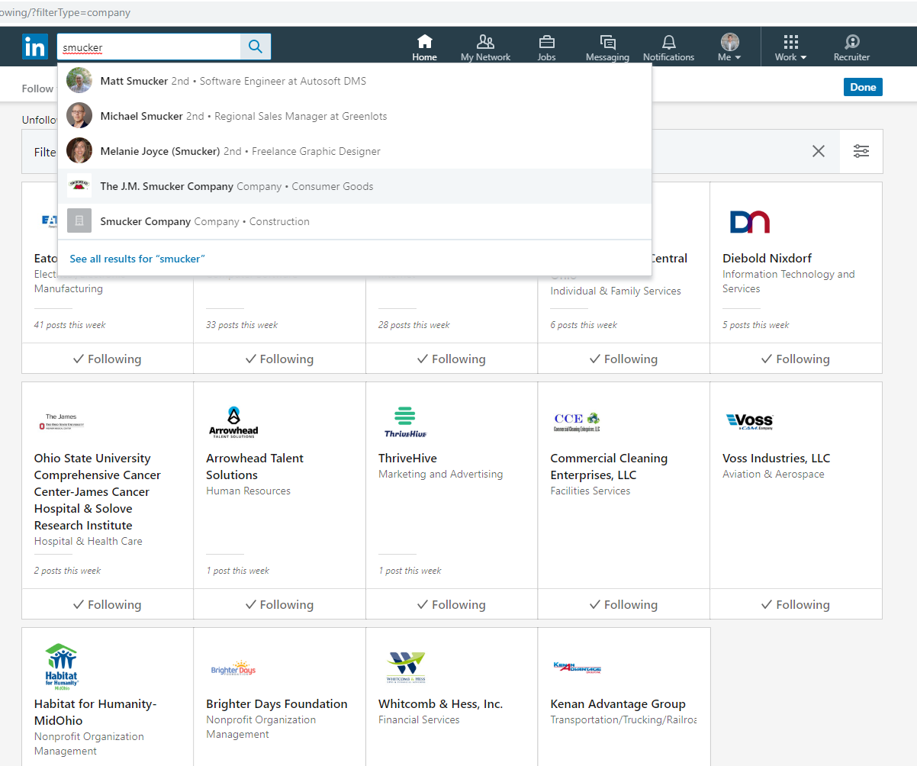
How to research a company
Search

Slide 16
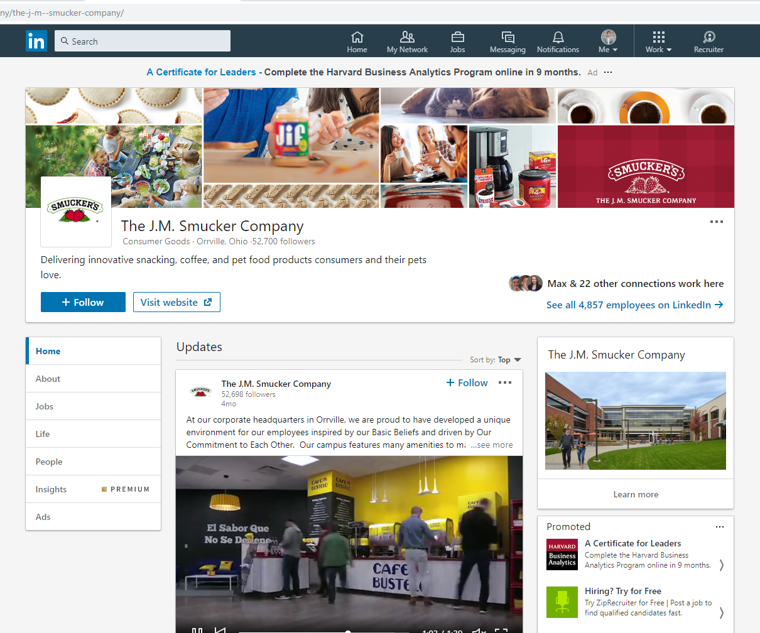
How to research a company

Slide 17
Use as a sales tool
If you don’t know them, get to know them
Make connections
Upgrade to Premium for one month (free)
Send InMails (5 free) to prospects
Magic words: “Can I take you out to coffee?”
Research prospects and identify attractive opportunities

Slide 18
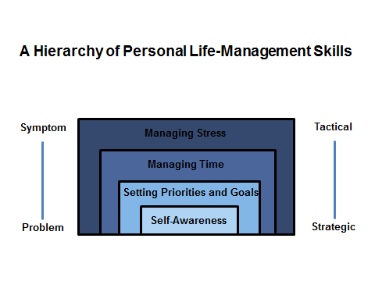
Self-awareness is foundational

Slide 19
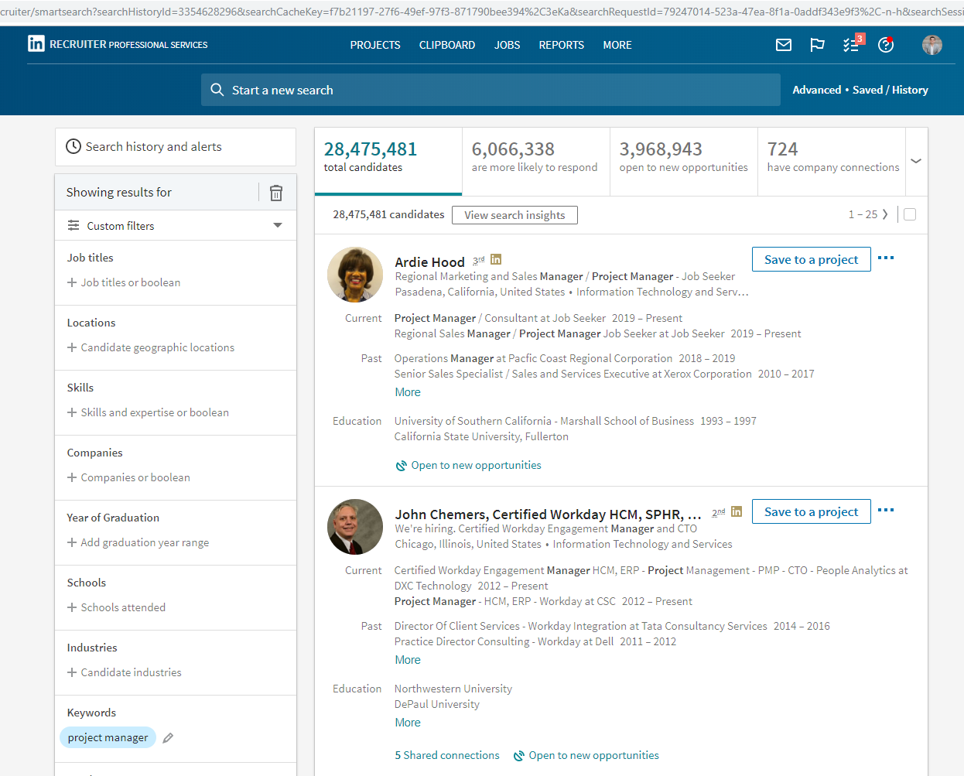
A recruiter’s perspective

Slide 20
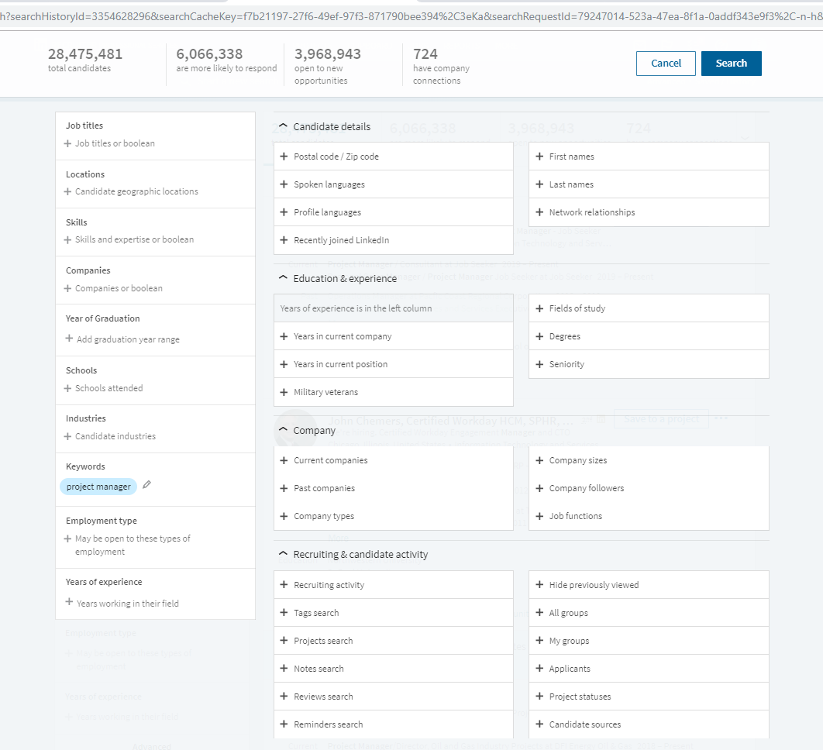
A recruiter’s perspective

Slide 21
Q & A

