Slide 1
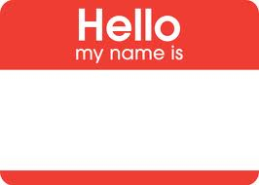
Informational Interviewing
Paul DiFranco
SPHR
Paul DiFranco
SPHR
1

Slide 2
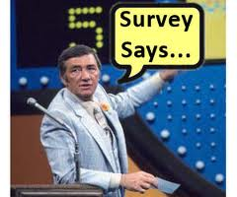
Percentage Jobs thru Networking?
65 - 85 % of jobs found through networking . . .
Harvard Business School
70 - 80% jobs that people hold been obtained through
networking . . . LinkedIn
80% of today's jobs landed through networking . . .
Recruiting Blogs
70% of jobs found through networking . . .
U.S. Bureau of Labor Statistics
Corporal Newkirk, RAF

Slide 3
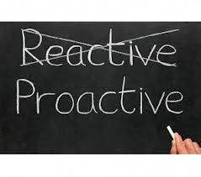
Reactive -- Responding to: postings, ads, etc.
- Vs. -
Proactive -- N-e-t-w-o-r-k-i-n-g

Slide 4
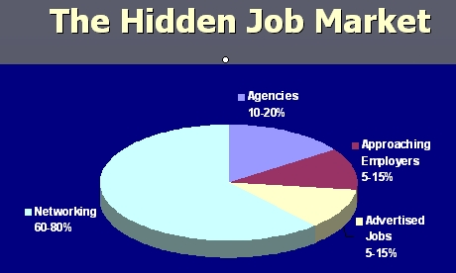
Tap into . . .
Most openings are not posted!

Slide 5
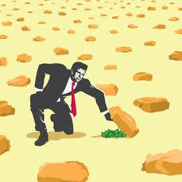
Where would you invest 70% of your job search time?
Applying for openings in Sunday News ads
Searching for job listings on LinkedIn
Sorting through and applying for jobs on: Career Board, Monster, CareerBuilder, Indeed, Simply Hired
Networking
J.B. Bryant
circa 1966

Slide 6
2 Main Ingredients of Job Networking
1. Talking with People i.e., Word of Mouth
2. Building Relationships i.e., more than once!

Slide 7
Where to Network?
Job Fairs
Trade and Professional Associations
Networking Events
Friends, Family, Social Gatherings / Organizations
Volunteer Jobs
Barbershops, little league games, garage sales, golf etc. etc. etc.
Informational Interviews

Slide 8
Informational Interviews
Meeting where Job Seeker asks for AIR i.e.., Advice, Information, Referrals.
Coined by Richard Nelson Bolles … What Color is Your Parachute?
May or may not be a specific job opening

Slide 9
How You Benefit?
Informational Interviewing
Learn relevant information first hand
Discover alternate career paths
Improve communication skills / confidence
Learn organizational culture
Gain self knowledge
Build your network - -Who else should I talk with?
Offer useful information
Get valuable info - resume, industry, job market

Slide 10
What Can I Offer My Contacts
Information Interviewing
Job Market Information
Introductions to New Contacts
Articles, books, websites
Simply Being Interested in THEM!
Latest Job Search Tips & Trends
Allows them to “Do Good to Feel Good!”

Slide 11
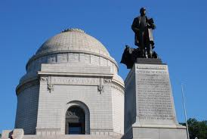
How Do You Get to TOP of McKinley Monument?
Q. Fun Fact – How many steps to the top?

Slide 12
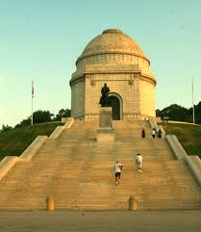
One Step at a Time!
A. 108 Steps

Slide 13
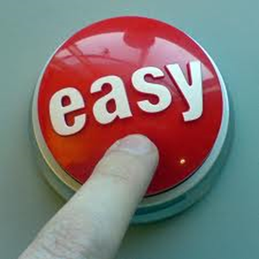
Informational Interviewing 6 Easy Steps
Build Contact List
Prioritize Contacts
Request Meetings
Prepare for Meeting
Conduct Meeting
Follow-up
13

Slide 14
Step 1: Build Your Contact List Contact Categories
Profession: Accounting, IT, Marketing, HR, Engineering, Sales, Supply Chain, etc.
2. Industry: health care, metals, energy, banking, insurance
education, retail, consulting etc.
3. Personal: Everyone else in your life that you respect and who respects you… family, friends, friends of friends, barbers, church members, etc.

Slide 15
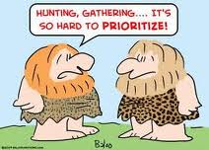
Step 2: Prioritize Your List
Start with people you know – build your confidence
Start where non- critical company / job on the table
Start where people have expressed an interest in helping you
Higher priority where people have fed you leads
Higher priority where they are in industries you prefer

Slide 16
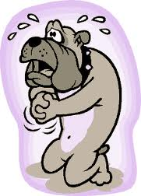
Step 3: Asking for Meeting
(sample script)
A. People You Know
Hi, (Joe). I’m calling to ask for a little advice . . . I’m back in the job market and looking to build my network. Could I have maybe 15-20 minutes to help gather info about job market that will help me move forward with my job search?

Slide 17
Asking for the Meeting
(sample scripts)
B. People You Don’t Know - Use a warm referral. Someone in common as a bridge to open door.
Hello (Betty), my name is _______, our mutual friend Steve Smith, recommended I talk with you as someone who might be willing to share some of your insights and experience with me on my job search.
Hi (Betty), I understand Steve Smith emailed that I would be in reaching out to you. I’m in the job market and looking to expand my network and seeking advise from people like you in the ______ industry.

Slide 18
Step 4 - A: Preparation Research Contact
Find out person’s background, profession,
company, industry, professional associations etc.
How would you do the above?

Slide 19
Step 4 - B: Preparation Setting the Agenda
State purpose of meeting
Establish a common interest or reference
Exchange info . . . Get more names, resume feedback,
Practice elevator speech etc.
4. Follow-ups …. Is it ok if I stay in contact? How best?
5. Summarize and close

Slide 20
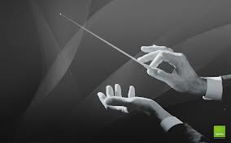
Step 5: Conduct Meeting
Follow your planned agenda
Ask 3-4 prepared questions
Stick to the amount of time you asked for
Do NOT ask for a job!!! Really!

Slide 21
Step 6: Follow – Up Meetings
AIR - - Advise Information Referrals
New information gathered since last met
Revisions to: resume / marketing strategy / elevator speech
Any more contacts
How you can help your contact
Provide feedback on your progress

Slide 22
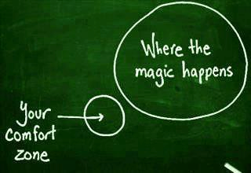
Proactive Means Making Things Happen!
Faith Sheaffer-Polen
Paul DiFranco
22

Slide 23
Comfort Zone
Staying in comfort zone too long - - we get stuck!
23

Slide 24
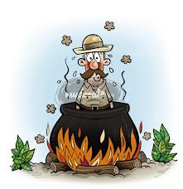
Panic Zone
Dr. Livingstone I presume?
To rapid of change can lead to excessive stress, anxiety, and reverting!
24

Slide 25
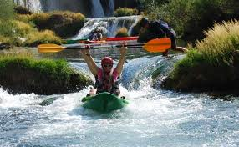
Stretch Zone
Change Happens Best Here
25

Slide 26
Informational Interviewing
Paul DiFranco, SPHR
HR Pro Solutions MMXIII
26

