Slide 1
How to Hire Your
Best Employer
Timothy G. Lybarger
Executive director, encore neo
EncoreNEO.org
May 17, 2022

Slide 2
Goals for Today
Introduce you to a new perspective. (Warning: Reality check ahead)
Have you answered three essential questions:
Who do you want to work with?
What problem do you want to help them solve?
What is your one best super power?

Slide 3
Tim Lybarger
Founder & Executive Director, Encore NEO (2014)
Hospitality
Machining
Real Estate
Aviation
Construction
Electric Utility
Consumer Packaged Goods
Independent Consulting

Slide 4
What’s the Root of the Problem?
“For every thousand hacking at the leaves of evil, there is one striking at the root.”
-- Thoreau

Slide 5
The Industrial Society
A society driven by the use of technology and machinery to enable mass production, supporting a large population with a high capacity for division of labor.

Slide 6
An imbalance of power and loss of control
Most jobs exist in private autocracies, dictating:
Where to be and at what time.
What to do.
What to say.
What to wear.

Slide 7
Here’s the deal…
“Fit in, and do the job we hired you for (until we decide to change it), then go away when we are done with you.
– in exchange for the perception of security and prosperity.

Slide 8
System and Structure Bias/Imbalance
Automated hiring systems with built in age biases
What year did you graduate?
Unfair power advantage from the get-go
Previous salary history?
Candidate dependencies
Financial debt (consumer society)
Healthcare costs
Learned helplessness
Distractions

Slide 9
The Goal is…
Freedom: Control over our own time and attention.
(Choice)
Hiring the best employer.

Slide 10
Let’s flip the script to “Hire the Best Employer”
Determine who you want to work with and what problem you want to help them solve. (The fishing line – see corresponding files on NCENG website)
Build a Personal Business Model.
And maybe a personal website
Determine to be so good that you can’t be ignored.
Constant investment in building career capital
Build a Brain Trust (Mastermind Group).
Be brutal at eliminating all distractions.
Use only side-door strategies. (Relationships first)
Never, ever, ever lead with resumes and online applications.
Decrease my dependencies. Never be a position where you can’t just walk away.
Frugality (learn to live better on less)

Slide 11
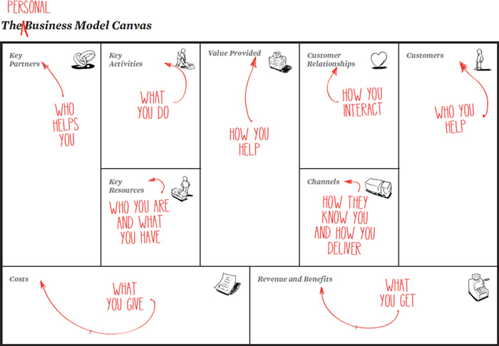
How?

Slide 12
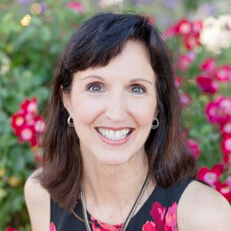
What if we flipped the script?
Environmental Assurance Engineer
“I help plant managers sleep better at night, knowing that their facilities are in compliance!”
Annette

Slide 13
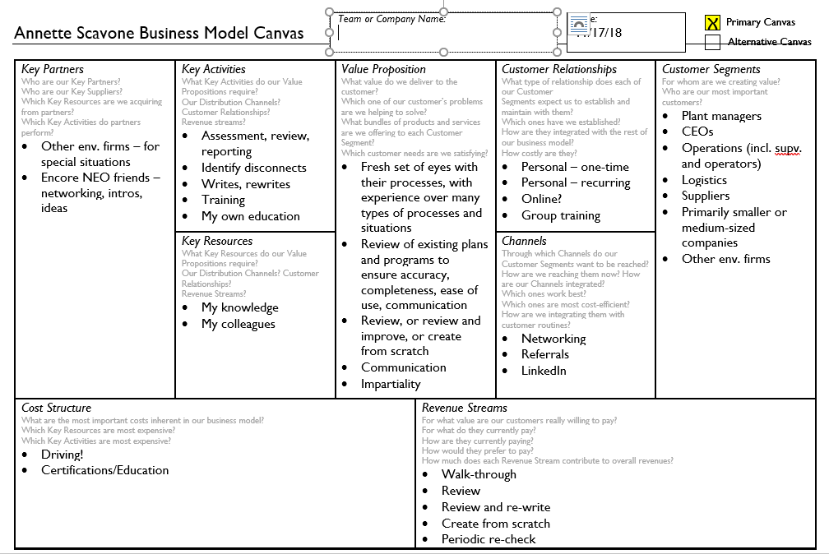

Slide 14
How?

Slide 15
Breakout Questions
Whom do you want to work with?
What problem do you want to help them solve?
What is your one greatest super power?

Slide 16
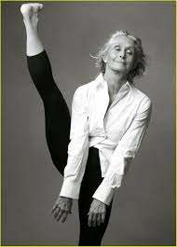
It is Time to Claim Our Freedom
“We are sometimes truly going to see our life as positive, not negative, as made up of continuous willing, not of constraints and prohibition.”
-- Mary Parker Follet
Twyla Tharp

Slide 17
Encore NEO: New Employment Options
We help Age-50+ individuals design and build new careers around the things
that inspire them.
Tim Lybarger
Encoreneo50@gmail.com
www.Encoreneo.org
May 12 Weekly Program Update
Subscribe

Slide 18
Staying Calm, Centered and Focused
During the Interview Process
Does interviewing make you nervous? You may be mentally prepared, but are you emotionally prepared?
Join us to look at the emotional side of interviewing. Find out how to center yourself so that you can be fully present and at your best when you show up.
This free event will be led by Maria Barrett, Certified Energy Psychology Practitioner. Maria’s experience includes theater, IT troubleshooting, 30 years of Tai Chi and, of course, lots of interviewing.
REGISTER HERE

Slide 19
Recommended Resources:
Clark, Tim. Business Model You; A One-Page Method for Reinventing Your Career. John Wiley and Sons, 2012.
Newport, Cal. So Good They Can’t Ignore You: Why Skills Trump Passion in the Quest for Work You Love. Grand Central Publishing, Hachette Book Group, 2012.
Newport, Cal. Deep Work: Rules for Focused Success in a Distracted World. Grand Central Publishing, Hachette Book Group, 2016.
Newport, Cal. A World Without Email: Reimagining Work In An Age Of Communication Overload . Penguin Random House LLC, 2021.
McKeown, Greg. Essentialism: The Disciplined Pursuit of Less. Currency, Crown Publishing Group, 2014.

