Slide 1
Networking for Career Success
Building Mutually Beneficial Relationships for a Lifetime
Notes:
Networking is a skill you need to find AND keep a job.
Not talking today about meeting with lots of people to see what they can do for you.
Intentional work to build mutually beneficial relationships for a lifeline.
Pay it forward.

Slide 2
Took the Package
Applied anywhere
Real Estate bill
NCENG
Hair Salon
Interviews
Surprise!
Notes:
One November, IT assistant manager was laid off. Devastated, discouraged and hurt. Prayed, walked and started cleaning closets.
January, Pat Fladung called him and invited him to NCENG. Came to several meetings.
Looked online, applied everywhere: Best Buy, Home Depot, LinkedIn
Real estate bill; How pay? Looked online for comparisons. Saw job post for assistant IT director for Stark County Auditor’s office. Applied.
No response. Wife at hair salon. Hair dresses said her nephew is auditor. Immediate text.
Interviews (during mother’in’laws calling hours, etc) Wait.
Interviewing as freight specialist for Home Depot, Auditor’s office called. Auditor said he checked with a friend on the board of his previous company. He put in a good word
Started new job March 25.

Slide 3
Where is Your Next Job?
70% of Jobs Are Hidden

Slide 4
Connecting Opens Doors to “Hidden” Jobs
Harvard Business School
65% - 85% of jobs are found through networking
LinkedIn
70% - 80% of new jobs were obtained through networking
Recruiting Blogs
80% of today’s jobs are landed through networking
U.S. Bureau of Labor Statistics
70% of jobs are found through networking

Slide 5
How are YOU Spending Your Time?

Slide 6
What is networking?
Notes:
Friendliness and ability to engage.
Interaction with other people to exchange information and develop contacts, especially to further one's career.
The exchange of information or services among individuals, groups, or institutions; specifically the cultivation of productive relationships for employment or business.
When you combine these attributes, you will have uncovered the secret of powerful connections that lead to RICH relationships.
Jeffrey Gitomer (born February 11, 1946 in West Palm Beach, Florida) is an American author, professional speaker, and business trainer, who writes and lectures internationally on sales, customer loyalty, and personal development. He lives with his family in Charlotte, North Carolina.
Gitomer has written thirteen books, including New York Times best sellers, The Sales Bible^{[3]} and The Little Gold Book of YES! Attitude.^{[4]} His most successful title, The Little Red Book of Selling, has sold more than five million copies worldwide and has been translated into 14 languages.

Slide 7
Value of Informational Interviews
Learn relevant information first hand – industry, job market
Discover alternative career paths
Improve communication skills and confidence
Learn organizational culture
Offer useful information
Request feedback on your resume, career goals

Slide 8
How to Network for Career Success
Why Network?
How Find the Right Person?
How to Invite?
How to Conduct Meeting?
After Meeting?
Bonus Secrets!
Notes:
Networking is NOT about finding people to do your bidding in the job search!
Networking is building your circle of influence – friends, coworkers, clubs, business associates, neighbors. We network to benefit other people and try to solve their problems, even a little.
People you rely on for information and support. They rely on you for ideas and strength. You encourage each other.
Sometimes you outgrow each other or move on. Sometimes good things happen to keep you together. Sometimes bad things happen that make networks grow apart.
But, while they are present, networks play a powerful role in your life.

Slide 9
Table Discussion: 1) Why don’t we network 70%-80% of our job search time? 2) Solutions?
Notes:
Everyone wants to be rich.
Although most people think being rich is about having money, rich is a description for everything BUT money.
RICH relationships lead to much more than money.
They lead to success, fulfillment and wealth.
Like the spider, we always need to expand and repair our network.
A change in one part of the network, impacts other contacts.

Slide 10
Universal Truth of Connecting
The question is not . . . “Whom do you know?”
The REAL question is . . . “Who knows YOU?”
Notes:
Who is in your circle of influence? Within that group, are you a leader or a participant?
Goal is to build your circle of influence and help each other.
Old saying: “You get what you want by helping others get what they want.” Still true.
To climb the ladder of success, you don’t need more techniques and strategies, you need more friends.
Exercise: List the knowledgeable and connected people you know who are willing to help you.

Slide 11
LEADS
Friends
Family
Notes:
1st degree connections represent only a small portion of opportunities your network holds
2nd degree connections are exponentially larger than your current professional network.

Slide 12
Industry
Profession
Associations
Government
Volunteers
Friends
List your 10 most powerful connections
What I have done for these people lately?
Notes:
WITH WHOM SHOULD YOU NETWORK?
Powerful connections are people who can make things happen, and make things happen for you.
Exercise: List your connections in
Government
Your industry (healthcare, education, manufacturing, retail)
Your profession (HR, IT, sales, communications, product management, engineering)
General business (chamber of commerce)
Professional associations
Volunteer organizations

Slide 13
Why Network?
How Find the Right Person?
How to Invite?
How to Conduct Meeting?
After Meeting?
Bonus Secrets!
If you want to connect with someone:
Find a way to help that person.
Be intriguing.
Think people, not positions.
Be generous.
Excerpted from Power Relationships by Andrew Sobel
Notes:
Be generous. Give before you ask. Comment on people’s status.
You may have something even those you see as wealthy/successful may need.
Be intriguing.
Successful executives identified 25-30 relationships that made all the difference to their careers.
Critical few. Follow up 2-3 times a year.
Next tier of 50-100 contacts who have helped you or have the potential.

Slide 14
Where Can You Build Your Network?
Professional associations –Volunteer for boards or committees
Business groups – Be selective, but get involved
Conferences – Offer to present or join a panel
Online communities – Be visible
Job fairs – Prepare. Know who will be there. Prioritize.
Parties – Stay alert. Ask for introductions.
Grocery store – Always be prepared!

Slide 15
Why Network?
How Find the Right Person?
How to Invite?
How to Conduct Meeting?
After Meeting?
Bonus Secrets!
Use LinkedIn
Follow key players at companies where you want to work
Make list of desired companies
Connect with people on your level
When you visit their profiles, show your profile
Like or comment on their posts
Wait to see if they reach out to you first
Ask to connect with them using a personalized message NOT the default
Notes:
100% complete profiles – 40x more opportunities
Join groups
Comment on friends’ status
Forward job listings
Update your status often

Slide 16
How to use LinkedIn to reach 2nd/3rd connections
Don’t depend only on the “jobs” feature on LinkedIn
Do ask for an introduction
Research, research, research
Don’t engage at an inappropriate level
Be direct and respectful of their time
Referred applicants are 5 times more likely than average to be hired
AND 15 times more likely to be hired than applicants from a job board
Source: Jobvite
Notes:
Introduction – personal, relevant. Genuine, upfront. Don’t hound.
Legitimate reason to comment on a post
Jobvite: Used by LinkedIn to hire
Funnel from current website: visitors/applications/interviews/offers/hires

Slide 17
The Ask: Easier Than You Think!
People you know
People you don’t know
Hi (Joe). I’m calling to ask for a little advice . . . I’m in the job market and looking to build my network. Could I have maybe 15-20 minutes with you to help gather info about the job market that will help me move forward with my job search?
Hello (Allison). My name is ______. Our mutual friend _____ recommended I talk with you as someone who might be willing to share some of your insights and experience with me on my job search.

Slide 18
Create your Elevator Speech
Objective: Describe yourself quickly and make yourself memorable.
What value do you provide? Example: I develop integrated communications programs that help customers, investors, employees and others understand and support company initiatives.
How do you provide this value? Example: Today, your customers check multiple sources to stay informed. I research each audience well to make sure targeted messages are delivered effectively on their favorite media, like Facebook, online news feed, Twitter and email.
What is unique about your offer? Example: I tailor each message so it feels personal, believable and relevant. For example, when launching a new product, I describe it differently to dealers who care about profitability, compared to customers who want it to solve a problem.
Call to action. Example: Tell me your biggest communications challenge and let’s develop a solution together.
Notes:
PRACTICE AT TABLES
The pitch isn’t your autobiography or a detailed business plan, it’s an overview of who you are, what you do and how you can help the listener. It’s you selling yourself in a brief and concise manner, using a format that most people are familiar with. Whilst the elevator pitch is similar to your personal brand statement and bio, it’s delivered verbally and thus should have a slightly different wording to be punchy and memorable.
Use at industry conference, a networking event, a seminar or just taking the elevator at your hotel – there are always opportunities to strike up business relationships.

Slide 19
A Advice
I Information
R Referrals
Notes:
HOW CAN YOU INITIATE NETWORKING?
BIGGER THAN SIMPLY LOOKING FOR A JOB!
Build long-term, mutually beneficial relationships.
Ask for advice:
What makes you successful in your job?
How did you choose to work with your current employer?
What skills are needed to move ahead in (your profession)?
Ask for information:
How are people recognized for their work here?
What is a typical career path in your company?
How would you describe the organizational culture?
Ask for referrals:
Can you think of other companies I should contact during my search?
Do you know anyone who could provide additional helpful information?
Who are the influencers in (your profession)?
Who else might be able to help me in my career development?
Ask: What can I do to help YOU?

Slide 20
R Research
R Reciprocate
R Relationship building
Notes:
BIGGER THAN SIMPLY LOOKING FOR A JOB!
Build long-term, mutually beneficial relationships
Research:
Prepare yourself for informational interviews by researching your contact on LinkedIn, Google search and mutual friends.
Learn about where they have lived, their educational background, where they have worked, responsibilities they have had.
See if you have any mutual friends/history.
Reciprocate:
Offer to provide information and connections to your contact.
Forward relevant news items, industry changes, personnel updates and more to your contacts.
Ask what you can do for him/her.
Relationship building:
Ask if you can keep in touch. If so, ask how the person likes to receive updates: phone calls, emails, texts, Messenger, postal mail
Deduce during the conversation what that person in particularly interested in. If unsure, ask.
Offer to be a resource to that person and his/her friends.

Slide 21
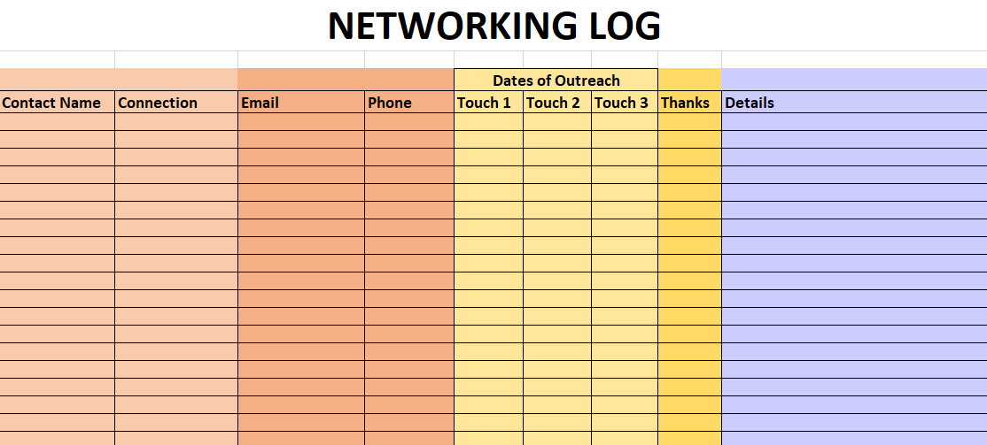
Notes:
42% more likely to achieve your goals and dreams, simply by writing them down on a regular basis.
Timeline:
Weekly to-do list: How many contacts to make? Number of informational interviews? NCENG recommends identifying 3 new companies each week and contacting 3 employees at each company.
Daily schedule: Budget time for your job search (networking, applying for jobs, following up), physical activity; family; personal interests. NCENG recommends spending 80% of your job search time networking because 80% of jobs are found through networking.
Set milestones to accomplish every 2 weeks of month to help you stay on track.

Slide 22
Why Network?
How Find the Right Person?
How to Invite?
How to Conduct Meeting?
After Meeting?
Bonus Secrets!
Prepare by researching that person’s career, interests, education, etc.
State the purpose of the meeting.
Establish a common interest/reference.
Ask 3-4 prepared questions.
Exchange information. Get more names and/or resume feedback.
Practice elevator speech and get advice.
Stick to the amount of time you requested.
Agree on follow-up. (Is it ok if I stay in contact? How best?)
Summarize and close.
Do NOT ask for a job. Really!

Slide 23
Why Network?
How Find the Right Person?
How to Invite?
How to Conduct Meeting?
After Meeting?
Bonus Secrets!
Does your contact want to stay connected?
What is that person’s preferred communications channel?
Text
Email
LinkedIn
Periodic updates on your job-search process (very effective)
Ask how you can reciprocate
Perhaps you can refer someone with a particular skill set as you network widely
Send 2 Thank you Notes:
1 electronic and 1 handwritten

Slide 24
Take it up a Level!
Why Network?
How Find the Right Person?
How to Invite?
How to Conduct Meeting?
After Meeting?
Bonus Secrets!
How to Tune in to other people:
Read body language
Mirror their movements
Identify their learning channels
Assess personalities quickly

Slide 25
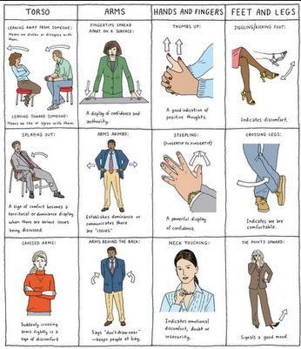
Body Language

Slide 26
Mirroring body language, tone of voice, cadence
Notes:
Mirroring or synchronous behavior makes others feel at ease. Slow-motion video shows this can extent to blinking, nostril flaring,yawning, eyebrow-raising and pupil dilation which is remarkable because this micro-gestures cannot be consciously imitated.
People who feel similar emotions and experience a rapport will begin to match each others body language and expressions. Natural inclination.
We mirror each other’s body language as a way of bonding and creating rapport, but usually oblivious to the fact we are doing it.

Slide 27
Personality Traits
Notes:
DISC is a behavior assessment tool based on the DISC theory of psychologist William Moulton Marston, which centers on four different personality traits which are currently Dominance (D), Influence (I), Steadiness (S), and Conscientiousness (C).^{[1]}. This theory was then developed into a behavioral assessment tool by industrial psychologist Walter Vernon Clarke.
Marston was a lawyer and a psychologist; he also contributed to the first polygraph test, authored self-help books and created the character Wonder Woman.
DISC has been used to help determine a course of action when dealing with problems as a leadership team—that is, taking the various aspects of each type into account when solving problems or assigning jobs

Slide 28
Available online, in print – or at Job Testing Centers!
Choose statement that MOST describes you
Choose statement that LEAST describes you
Notes:
Self-assessment
Useful for relating to other people
Sometimes used for pre-employment assessments

Slide 29
