Slide 1
Passions + Strengths ___________________________________________________ Practical Solutions
Janet Matelski-Smith
Tuesday, March 1, 2016

Slide 2
With everything that has happened to you, you can either feel sorry for yourself or treat what has happened as a gift. Everything is either an opportunity to grow or an obstacle to keep you from growing. You get to choose.
-Wayne W. Dyer

Slide 3
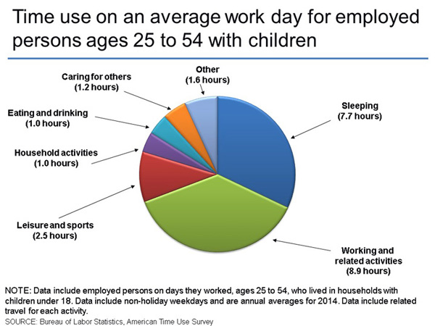

Slide 4
(~ 6.5 hrs)
(~ 6.0 hrs)
(11.5 hrs)
CNN Work-life balance calculator:
http://www.cnn.com/2008/HEALTH/10/23/balance.calculator/index.html?iref=allsearch

Slide 5
More Than Job Satisfaction
“Finding meaning in one’s work has been shown to increase motivation, engagement, career development, job satisfaction and personal fulfillment”
“Only 30 percent of the U.S. workforce is engaged in their work”
“Active disengagement costs U.S. companies $450-$550 billion per year”
Building a Cathedral
Weir, K. (2013, December 13). American Psychological Association, Vol. 44, No. 11, p. 39
http://www.apa.org/monitor/2013/12/job-satisfaction.aspx
Notes:
Of course, there are different ways to find meaning in one's work, says Michael G. Pratt, PhD, a professor of management and organization at Boston College. To illustrate this, he points to the old tale of three bricklayers hard at work. When asked what they're doing, the first bricklayer responds, "I'm putting one brick on top of another." The second replies, "I'm making six pence an hour." And the third says, "I'm building a cathedral — a house of God."

Slide 6
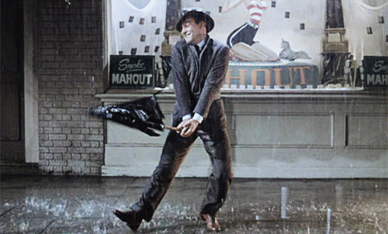
Choose a job you love, and you will never have to work a day in your life. -Confucius

Slide 7
What I’m REALLY Good At:
Organizing – people & things
Facilitating
Mentoring / Coaching
Analysis / Stats
Communication – verbal
Communication – written
Communication – listening
Learning

Slide 8
What I REALLY Enjoy:
Learning
Collaborating
Teaching
Mentoring / Coaching
Organizing – people (things?)
Problem-Solving
Facilitating
Painting

Slide 9
What I’m REALLY Good At:
What I REALLY Enjoy:
Organizing – ppl & things
Facilitating
Mentoring / Coaching
Analysis / Stats
Communication – Verbal, Written, Listening
Learning
Documentation
Problem-Solving
Collaboration
Learning
Collaborating
Teaching
Mentoring / Coaching
Organizing – ppl (things?)
Problem-Solving
Facilitating
Painting
Home Improvements

Slide 10
What I’m REALLY Good At:
What I REALLY Enjoy:
Organizing – ppl & things
Facilitating
Mentoring / Coaching
Analysis / Stats
Communication – Verbal, Written, Listening
Learning
Documentation
Problem-Solving
Collaboration
Learning
Collaborating
Teaching
Mentoring / Coaching
Organizing – ppl (things?)
Problem-Solving
Facilitating
Painting
Home Improvements

Slide 11
What I’m REALLY Good At:
What I REALLY Enjoy:
Organizing – ppl & things
Facilitating
Mentoring / Coaching
Analysis / Stats
Communication – Verbal, Written, Listening
Learning
Documentation
Problem-Solving
Collaboration
Learning
Collaborating
Teaching
Mentoring / Coaching
Organizing – ppl (things?)
Problem-Solving
Facilitating
Painting
Home Improvements

Slide 12
What I’m REALLY Good At:
What I REALLY Enjoy:
Value
Organizing – ppl & things
Facilitating
Mentoring / Coaching
Analysis / Stats
Communication – Verbal, Written, Listening
Learning
Documentation
Problem-Solving
Collaboration
Learning
Collaborating
Teaching
Mentoring / Coaching
Organizing – ppl (things?)
Problem-Solving
Facilitating
Painting
Home Improvements

Slide 13
Value | Hrs / wk | %
5 | 31-40⁺ | 76-100%
4 | 21-30 | 51-75%
3 | 11-20 | 26-50%
2 | 6-10 | 15-25%
1 | < 6 | < 15%
Value Scale

Slide 14
What I’m REALLY Good At:
What I REALLY Enjoy:
Value
Organizing – ppl & things
Facilitating
Mentoring / Coaching
Analysis / Stats
Communication – Verbal, Written, Listening
Learning
Documentation
Problem-Solving
Collaboration
Learning
Collaborating
Teaching
Mentoring / Coaching
Organizing – ppl (things?)
Problem-Solving
Facilitating
Painting
Home Improvements
5
4
3
1
2
4

Slide 15
Value | Hrs / wk | %
5 | 31-40⁺ | 76-100%
4 | 21-30 | 51-75%
3 | 11-20 | 26-50%
2 | 6-10 | 15-25%
1 | < 6 | < 15%
Value Scale

Slide 16
Now What? (next steps)
Ask your:
Family
Friends
Networking Contacts
Former Co-Workers / Bosses
What am I REALLY good at?
What do I REALLY seem to enjoy?
(add these results to your list)

Slide 17
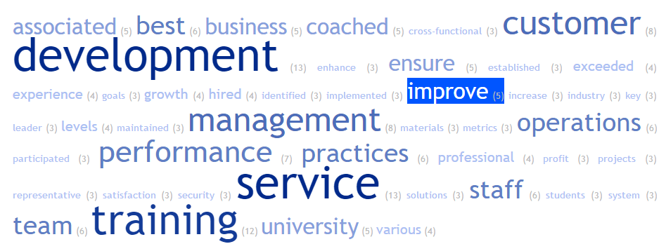
Additional Resources: TagCrowd.com
Resume Results:

Slide 18
Additional Resources: TagCrowd.com
Good At / Enjoy Assessment Results:

Slide 19
Additional Resources: Self-Assessment Tools
Holland Code Quiz – work personality assessment http://www.roguecc.edu/Counseling/HollandCodes/test.asp

Slide 20
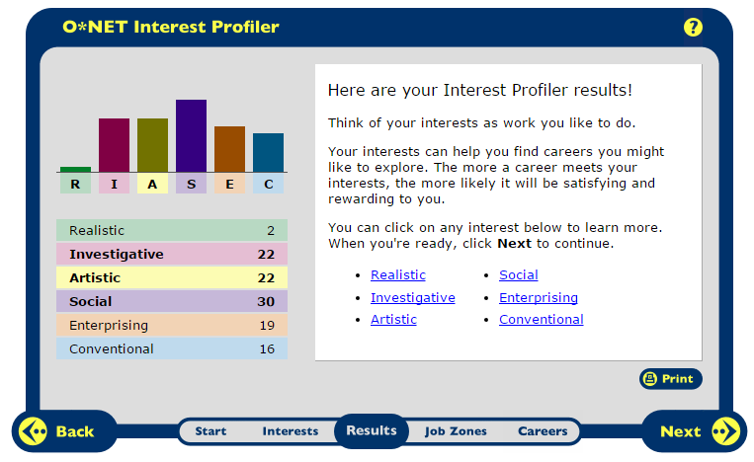
O*NET Online
Interest Profiler* at My Next Move http://www.mynextmove.org/explore/ip
*Same survey is available on ohiomeansjobs.com and can be saved for future reference

Slide 21
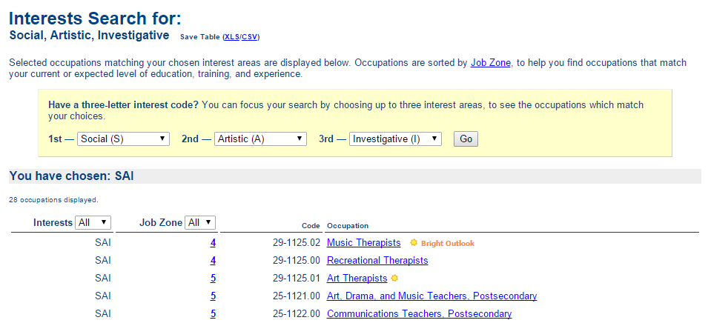
O*NET Online
Interests Search – Holland Codes http://www.onetonline.org/explore/interests/Social/Artistic/Investigative/

Slide 22
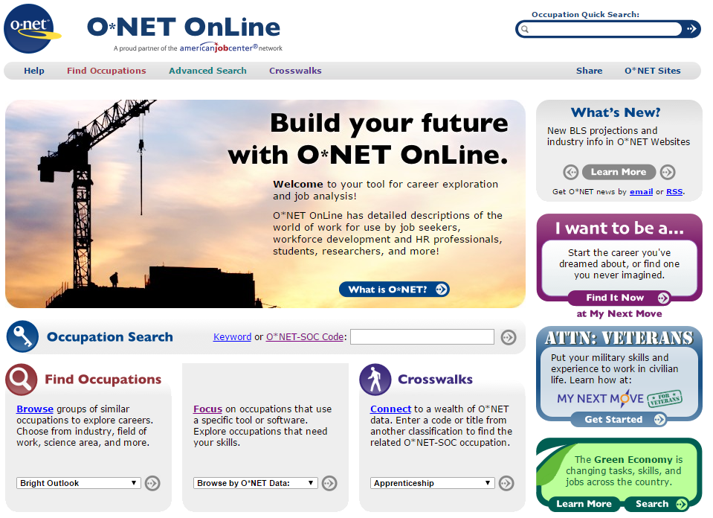

Slide 23
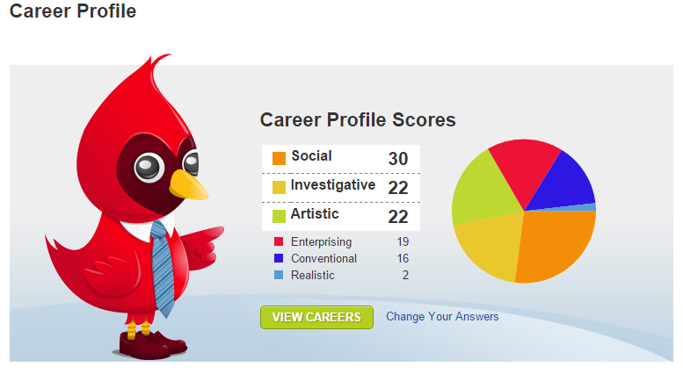
Ohio Means Jobs
Career Profile in Backpack https://jobseeker.ohiomeansjobs.monster.com/ExploreIt/Default.aspx

Slide 24
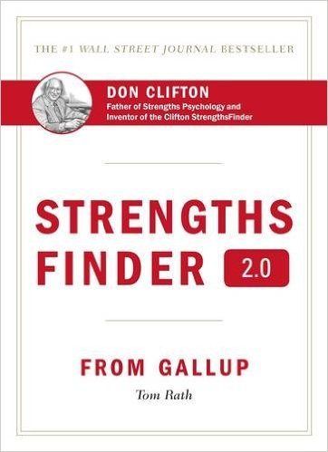
Additional Resources: Self-Assessment Tools
StrengthsFinder 2.0
Myers Briggs Type Indicator (MBTI)
Golden Personality Type Profiler
What Color is Your Parachute?
How to Do What You Love for a Living

Slide 25
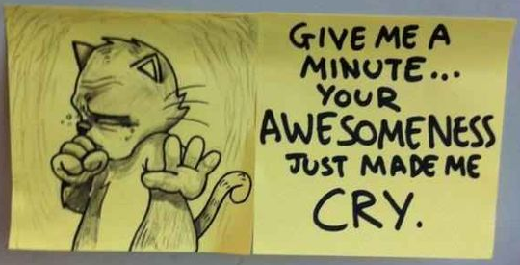
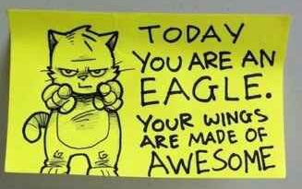
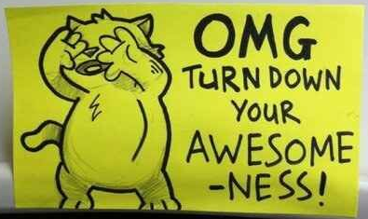
Parting Thoughts. . .

Slide 26
Thank you!

